Slide 1
SESSION 2: Rapid eTrade Readiness Assessments
(eT-Ready):
Helping countries take steps towards increased readiness to engage in and benefit from E-commerce
Rahul Bhatnagar
Programme Management Officer, ICT Policy Section
Science, Technology and ICT Branch
Division on Technology and Logistics
2 Mars 2018
P166 SHORT COURSES ON KEY ISSUES ON THE INTERNATIONAL ECONOMIC AGENDA
Assessing the eTrade readiness of the least developed countries for the promotion of sustainable development

Slide 2
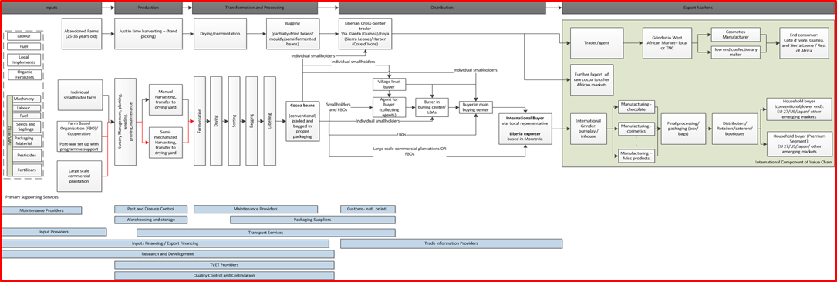
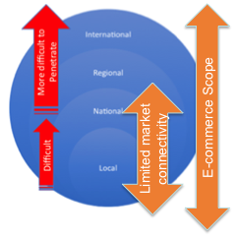
E-commerce as a development catalyst
Example – Liberia Cocoa value chain
A number of critical success factors
Connecting with markets
Trust Development especially with buyers
Ability to manage timely receipts and settlements
Legal and Regulatory Framework
Transport and logistics
Access to inputs (including human capital)
Access to finance
(import/export etc )
Clearing customs and paperwork
Markets drive operations throughout the value chain
Developing and sustaining relationships with
buyers in international markets is a challenge
for developing countries, especially LDCs

Slide 3
E-commerce as a development catalyst
Contribute to sector development across the economy , e.g. Tourism
Contribute to reducing the high import dependency vis-à-vis consumption goods in the domestic market
Bring previously disconnected private sector actors closer to markets, and vice-versa
Support inclusive economic growth involving increased economic participation by the private sector, including youth
Enhance trade competitiveness of Liberian firms by:
(a) facilitation of inputs sourcing for productive gains (B2B)
(b) Facilitation of Liberian exports to international markets (B2B, B2C)
Assist in developing a strong support supply chain such as IT professional services, website development
Medium - Long term
Short term
Medium term
E-commerce brings buyers and sellers together, encourages private sector activity, which spurs development gains

Slide 4




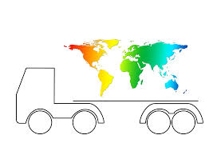
Harnessing E-commerce requires a concerted effort by a multitude of stakeholders in several policy and technical areas…
E-commerce ecosystem has many moving parts and actors..
..and a number of technical areas to address
Policy and strategy
development
Ministries + Technical Agencies
ICT Service Providers
Commercial Banks
E-Commerce firms
Regulatory authorities
Postal Services
Consumers
Universities and Certificate level training course providers
Logistics Services
Telecommunication firms
Customs
+
ICT Infrastructure
Markets access
Access to Finance
and Payments
Logistics + Trade Facilitation
Institutional
Support
Socio-economic impact
Legal and Regulatory
Framework

Slide 5
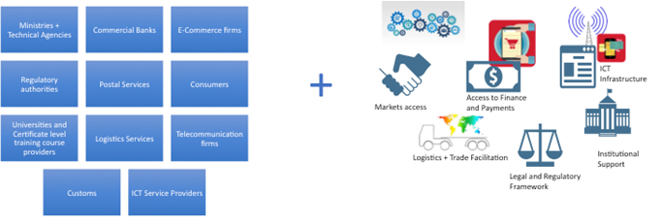
… and should lead to meaningful integration of e-Commerce into the National Development Agenda
National Development Plans, trade and sector export strategies must be adapted to include E-commerce
Policy and partnership platforms must include digital economy and E-commerce as active agenda items
The legal and regulatory framework must adapt to accommodate E-commerce
E-transactions law
Consumer protection
Data protection/privacy
Cybercrime adoption
E-commerce law
Intellectual property rights
Other related laws, acts, regulations

Slide 6
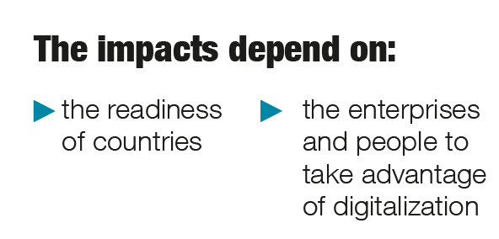
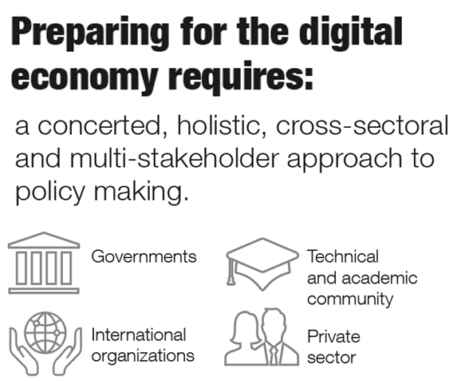
BOTTOM LINE:
Both opportunities and risks for developing countries

Slide 7
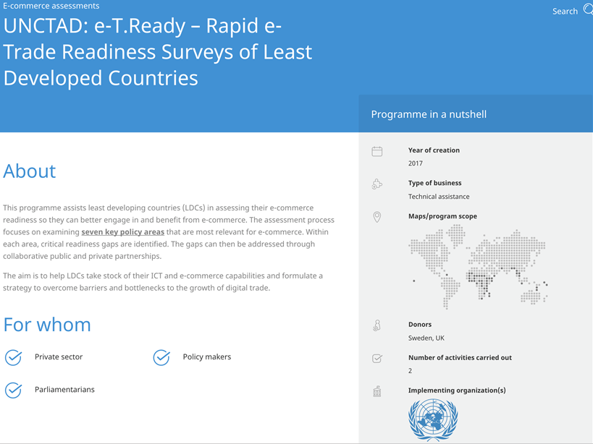

UNCTAD’s eTrade Readiness Assessments (aka eT-Ready)
A spin-off from ‘eTrade for all’ platform
In the pipeline:
2016 and 2017: Cambodia, Bhutan, Samoa, Nepal, Myanmar, Liberia, Lao PDR, Senegal
2018: Zambia, Ethiopia, Uganda, Solomon Islands, Vanuatu, Bangladesh, Malawi, Tanzania, Togo
-Rising Demand from non-LDCs as well

Slide 8
Scope of E-commerce?
“...the sale or purchase of goods or services, conducted over computer networks by methods specifically designed for the purpose of receiving or placing of orders”. (OECD)
Segments Include:
Business-to-business (B2B) Online sales between enterprises, including linked to outsourcing and offshoring.
Business-to-consumer (B2C) pure play" e-commerce enterprises and traditional bricks-and-mortar firms adding online sales channels.
Consumer-to-consumer (C2C): e.g. eBay and Taobao
Government-to-business (G2B): e.g. e-procurement
  Payment and delivery do not have to be conducted online
  Orders made by telephone calls, fax or manually typed e-mail excluded
Critical for developing countries, while they develop the relatively more sophisticated capabilities for online payments etc.

Slide 9
7 Policy Areas.. And (a subset of) what they entail
National policies related to ICT, e-government, e-commerce National policies related to trade, services, logistics E-government services National coordination (e-commerce task force, interministerial taskforce Public-Private Dialogue ?) | Ministry of Commerce Ministry of ICT Ministry of Planning Ministry of Economy / Finance Chambers of Commerce (national and foreign)
eT-Ready Scope
Ecommerce Assessments and Strategy
Formulation
ICT Infrastructure
Payment Solutions
Trade Logistics and Facilitation
Skills for e-Commerce Development
Legal and Regulatory Framework
Access to Financing and Technical Support
Banking penetration and financial inclusion A2F By banks and MFI A2F By business incubators, business accelerators, venture capitalists A2F By development partners | Central Bank Ministry of Finance Business Incubators Entrepreneurs Associations ADB, IFC
.
.
Broadband/Mobile/ smartphone penetration Reliability, affordability, latency, speed, coverage Major infrastructure projects (submarine cable, fiber optic, etc.) | Ministry of ICT Ministry of Post/Telecom Ministry of Infrastructure e-commerce vendors
Status of 4 key laws as per UNCTAD Cyberlaw tracker (available? up-to-date?) Other related laws, acts, regulations | Ministry of Commerce Ministry of ICT Ministry of Justice
Diversity of payment options Online payment gateways Switching networks E-Wallets | Central Bank Ministry of Finance Commercial Banking entities
Skill gaps identification Availability of tertiary education/curriculum, professional training Certificate level training | Ministry of Education Business Association Employers Association
Mode of delivery, last mile delivery (traffic, regulations) Physical addressing issues Regulatory issues at Customs: de minimis, risk management, etc. | Ministry of Transport Ministry of Post/Telecom World Bank (LPI) UPU (Postal Reliability) OECD (Trade Facilitation)
For E-commerce to thrive, all of these gears have to work in harmony

Slide 10
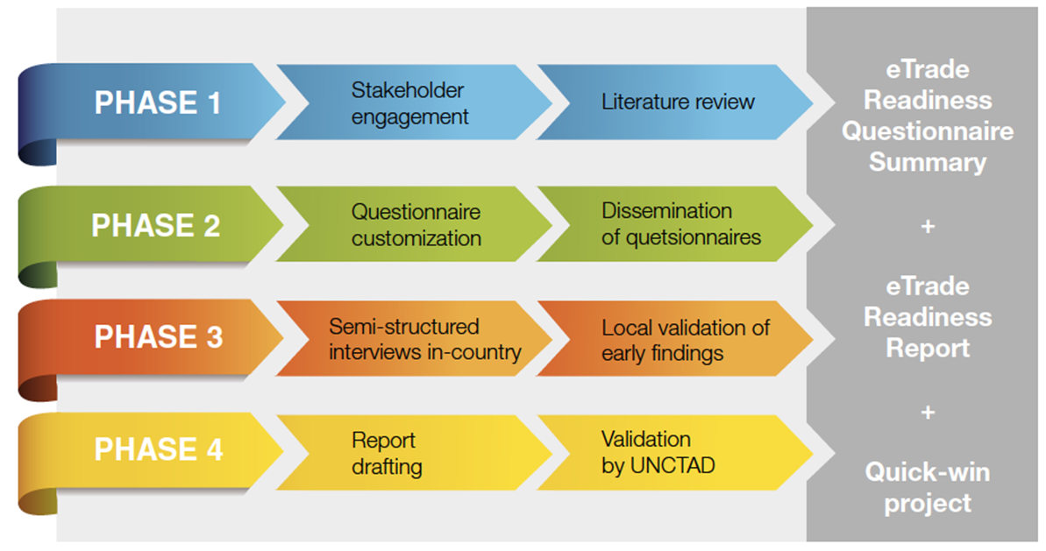
Methodology
Month 1
Month 2-3
Month 3
Month 3-4

Slide 11

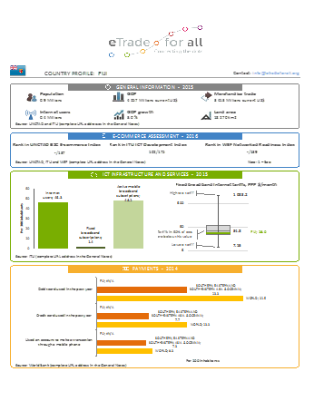
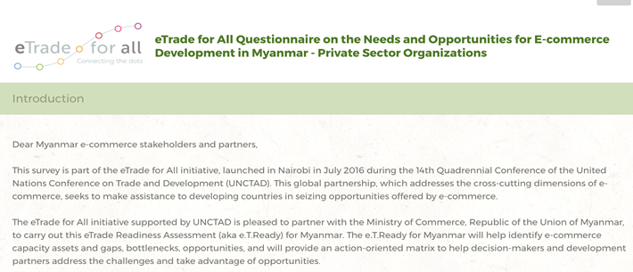
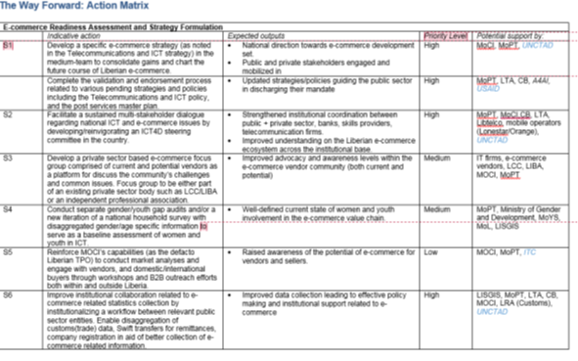
The Deliverables
Analyses
Survey Results
=
Action Matrix

Slide 12
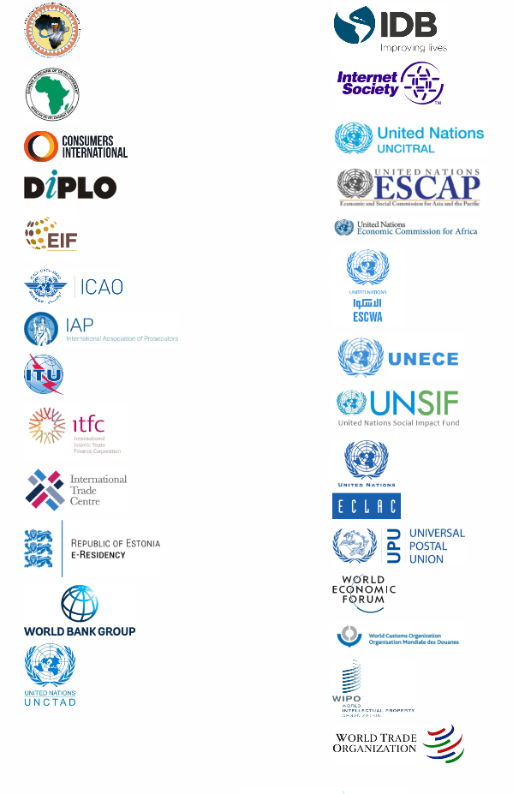

The benefit for countries
Helps policy makers see through the ‘digital’ fog, and therefore assists in policy making
demand-driven assessment, leading to consensus and country buy-in
Fit for Purpose
Identifies opportunities and constraints across the E-commerce ecosystem
help countries identify and prioritize areas in which they could benefit from assistance by partners of eTrade for All
.

Slide 13
Trends observed so far
Factors driving e-commerce growth in LDCs | Factors impeding e-commerce growth in LDCs
1. Tourism (especially food delivery services) has serves as an early adopter of ecommerce due to natural conditions
2. CoD and Mobile Payment options reduces the risk perception for consumers, and they are more willing to test online activity
3. Lead firms are paving the way for others, and also assisting in developing a feedback loop for updating regulations and upgrading supporting functions such as skills development.
4. Peer-to-Peer advertisements and transactions through social media are very popular, with Facebook being the top medium of choice.
1. Government engagement and integration of e-commerce in policy making for a (such as inter-ministerial groups) is stiill slow to emerge.
2. Trust development across a multitude of areas. will take time.
3. Consensus that the private sector will fast outpace the government (regulations) in terms of e-commerce development. While this is not currently a big issue due to the low base of e-commerce activity, the laws and regulations will need to catch up soon.
4. Low broadband penetration constrains fast e-commerce adoption.
5. Weak support supply-chain of ICT service providers
6. Lack of physical addressing is a significant constraint to last mile delivery.
7. Access to finance remains a persistant challange, and alternate mechanisms for payments have so far not yielded promising results
5. Active participation by youth has seen significant energy/innovation invested towards E-commerce.
6. Ongoing ICT initiatives ,albeit conducted in relative isolation, are helping to develop E-commerce the ecosystem
7. Bulk of incubators and accelerators in eT-Ready countries involve ICT start-ups.

Slide 14
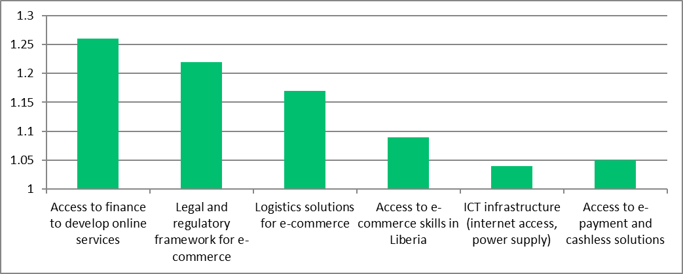
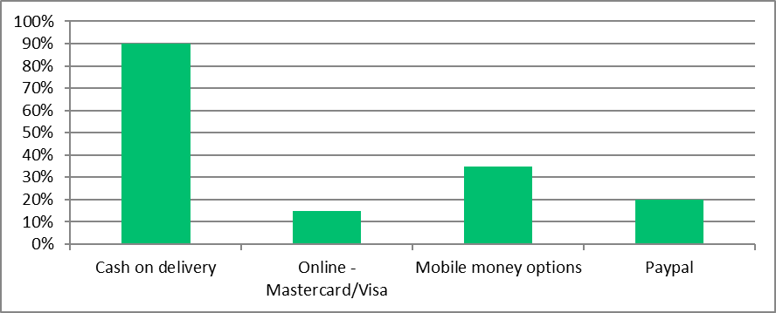
Trends observed so far
Connect with businesses outside the country
Improve connectivity in the hinterland
Investment in SME to actively develop e-commerce platforms
Adress the skills mismatch issue
Develop a cost effective and timely logistics process
More reliable fiber optic infrastructure
Expanding online payment gateways
Increased involvement of private sector in policy making processes
Improve last mile connectivity and last mile delivery
Representative across all eT-Ready countries regardless of geographical location

Slide 15

Select Case Studies (E-commerce Logistics Services)

Slide 16

Select Case Studies (Commercial ventures by Government Institutions)

Slide 17
Bottom Lines
1. E-commerce can act as a catalyst for a country’s development trajectory.
Attention towards E-commerce and the digital economy is fast becoming a necessity for developing countries, rather than simply an option
2. It must be meaningfully integrated in the national development agenda through a concerted effort by a multitude of stakeholders in several policy and technical areas
eT-Readys can help countries in fostering this focus
3. The time to act is now. The E-commerce divide is growing and developing countries are seeking to bridge/narrow the gap

Slide 18
When should a country reach out?
Disparate but unconnected development activity related to ICT, without focus on E-commerce
Stagnation of private sector development and trade initiatives due to lack of connectivity to markets
Requirement to enhance awareness and consensus within the overall E-commerce eco-system (Ministries, regulators, banks, telecoms, private sector, academia, service providers (ICT, trae logistics)
Need to galvanize the youth in entreprenaurship activities and open economic opportunities for women

Slide 19
Thank you for your attention!

