Slide 1

RMT 2018
Friday, 12 October 2018
Frida Youssef, Chief, Transport Section
Trade Logistics Branch Division on Technology and Logistics

Slide 2
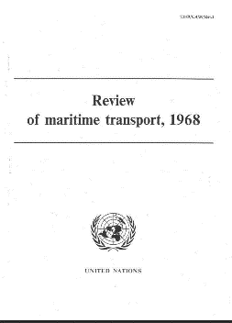
UNCTAD’s oldest Flag-Ship

Slide 3
Outline
The UNCTAD RMT 2018: 7 key trends
Protectionism
Excessive new capacity
Consolidation in container shipping
The relationship between ports and container shipping lines
Digitalization, e-commerce and the implementation of the Belt and Road Initiative
Scale
Climate change
Notes:
The Review has identified seven key trends that are currently redefining the maritime transport landscape and shaping the sector’s outlook. They entail the challenges and opportunities including for developing countries, which require continued monitoring and assessment for sound and effective policymaking:

Slide 4
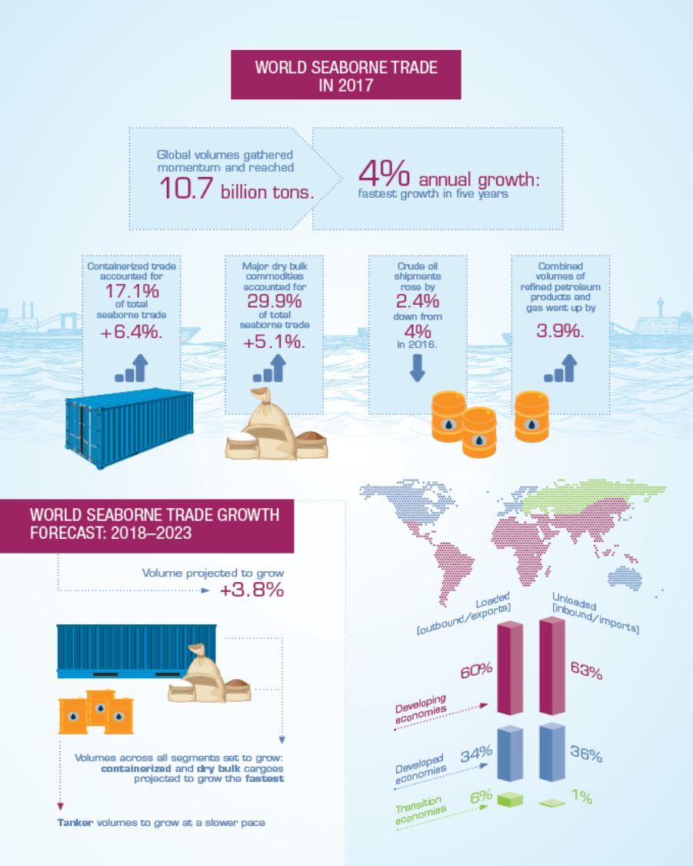
1) Protectionism: demand-side uncertainty arising namely from wide ranging geopolitical, economic, and trade policy risks
Growing seaborne trade in 2017
Volumes expanded at 4%, the fastest growth in five years.
Global containerized trade increased by 6.4%, following the historical lows of the two previous years (3.1% in 2016 and 1.1% in 2015).
Dry bulk cargo increased by 4%, up from 1.7% in 2016.
While growth in crude oil shipments decelerated to 2.4% down from 4% in 2016.
UNCTAD expects global maritime trade to grow by another 4% in 2018 and at an CAGR of 3.8% 2018 and 2023.
Uncertain outlook
While the prospects for seaborne trade are bright, downside risks such as increased inward-looking policies and recent rise of trade protectionism are, nevertheless, weighing on the outlook.
Notes:
World seaborne trade gathered momentum in 2017, with volumes expanding at a healthy 4%, the fastest growth in five years. Improved market fundamentals supported by an upswing in the world economy and more active global trade
In line with projected growth in world gross domestic product (GDP), UNCTAD expects global maritime trade to grow by another 4 per cent in 2018. Looking further ahead, world seaborne trade is projected to expand at a compound annual growth rate (CAGR) of 3.8 per cent between 2018 and 2023. Volumes across all segments are set to grow, with containerized and dry bulk commodities trades recording the best performances. Tanker trade volumes are also projected to increase, although at a slightly slower pace than other market segments, a trend consistent with historical patterns.

Slide 5
Trade War?
Escalating trade tensions
“…could derail recovery, reshape global maritime trade patterns”
Notes:
While the prospects for seaborne trade are bright, downside risks such as increased inward-looking policies and the rise of trade protectionism are, nevertheless, weighing on the outlook. An immediate concern is the trade tensions between China and the United States of America, the world’s two largest economies, as well as those between Canada, Mexico, the United States and the European Union. Escalating trade frictions may lead to a trade war that could derail recovery, reshape global maritime trade patterns and dampen the outlook. Further, there are other factors driving uncertainty. Among others, these include the ongoing global energy transition, structural shifts in economies such as China, and shifts in global value chain development patterns.

Slide 6
Developing countries continue to account for most of global seaborne trade flows, both in terms of exports (goods loaded) and imports (goods unloaded).
Developing countries shipped 60% of world merchandise trade by sea in 2017 and unloaded 63%
Major influence is Asia, with 42% of world maritime trade in 2017 originating in Asia and 61% being destined to the region
UNCTAD data
World seaborne trade, by region, 2017
(Percentage share in world tonnage)
Notes:
Developing countries continue to account for most of global seaborne trade flows, both in terms of exports (goods loaded) and imports (goods unloaded). These countries shipped 60% of world merchandise trade by sea in 2017 and unloaded 63% of this total. By contrast, developed countries saw their share of both types of traffic decline over the years and hover around one-third of world seaborne imports and exports (34% and 36 % of goods loaded and unloaded). Economies in transition continue to be heavily reliant on the export of bulky raw materials and commodities (6 per cent), while they hold a marginal share of global seaborne imports (1 per cent).
Historically developing countries were the main suppliers of high-volume, low-value raw materials, this has, however, changed over the years. As shown in figure 1.2 (a), developing countries have, over the years, emerged as prominent world exporters and importers. A milestone was reached in 2014 when developing countries’ share of goods unloaded (imports), surpassed for the first time ever, the group’s share of goods loaded (exports) This shift underscored the strategic importance of developing countries as the main driver of global seaborne trade as well as their growing participation in global value chains.

Slide 7
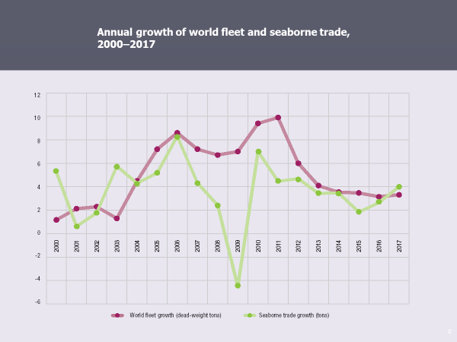
2) Excessive new capacity: oversupply capacity affects market fundamentals balance
From the supply-side perspective, 2017 saw a small improvement with a 3.3% growth rate in world fleet, after five years of decelerating growth.
However, overly optimistic carriers competing for market share and more efficient vessels may order excessive new capacity, leading to worsened shipping market conditions. This, in turn, will upset the supply and demand balance and have repercussions on freight-rate levels and volatility, transport costs, as well as earnings.
Notes:
On the supply side, after five years of decelerating growth, 2017 saw a small pick-up in world fleet expansion. During the year, a total of 42 million gross tons were added to global tonnage, equivalent to a modest 3.3% growth rate.
Compared to the growth rate of demand (4.0% in 2017), the lower growth in supply helped improve market fundamentals, leading to higher freight rates and profits for most carriers, with the exception of tankers (see also chapter 3).

Slide 8
3) Consolidation in container shipping: concerns remain
Container industry consolidation through mergers and alliances has been on the rise over recent years in response to lower demand levels and oversupplied shipping capacity dominated by mega container vessels.
While outright negative impacts on trade and costs have not been reported, there are remaining concerns about the impact of growing market concentration on competition and smaller players.

Slide 9
Consolidation persevered in the container market
In an oversupplied market, consolidation activities are likely to continue in container shipping; there remains the concern that the market structure shifts to a tight oligopoly. Therefore, regular monitoring and assessment of consolidation trends in this industry is an imperative.

Slide 10
In this respect, the seventeenth session of the Intergovernmental Group of Experts on Competition Law and Policy held in Geneva in July 2018, provided a timely opportunity to bring together competition authority representatives and other stakeholders from the sector to reflect upon some of these concerns and assess their extent and potential implications for shipping and seaborne trade, as well as the role of competition law and policy in addressing these concerns. Delegates called upon UNCTAD to continue its analytical work in the area of international maritime transport, including the monitoring and analysis of the effects of cooperative arrangements and mergers not only on freight rates but also on the frequency, efficiency, reliability and quality of shipping services.

Slide 11
4) The relationship between ports and container shipping lines: new dynamics
Alliance restructuring, and larger vessel deployment is also redefining the relationship between ports and container shipping lines whereby shipping lines have stronger bargaining power and influence.
Today’s port-operating landscape is characterized by heightened port competition, namely in the container market segment, where decisions by shipping alliances regarding capacity deployed, ports of call and network structure can determine the fate of a container port terminal.
Competition authorities and maritime transport regulators should also analyze the impact of market concentration and alliance deployment on the relationship between ports and carriers.

Slide 12
World container port throughput by region, 2017
(Percentage share in total 20-foot equivalent units )
Statistics on-line
UNCTAD data
Global port activity and cargo handling expanded rapidly in 2017, following two years of weak performance.
According to 2017 UNCTAD estimates, world container port throughput stood at 752 million TEUs.
The outlook for global port-handling activity remains positive overall, supported by projected economic growth and port infrastructure developments plans. However, downside risks weighing on global demand and related uncertainty continue to diminish global port activity.

Slide 13
5) Digitalization, e-commerce and the implementation of the Belt and Road Initiative : game changing trends
The unfolding effects of technological advances and China’s ambitious reordering of global trade infrastructure will entail important implications for shipping and maritime trade. The Belt and Road Initiative and growing e-commerce have the potential to boost seaborne trade volumes, while the digitalization of maritime transport will help the industry respond to the increased demand with enhanced efficiency.
Technological advances in the shipping industry, such as blockchain applications, cargo and vessel tracking, autonomous ships, and the Internet of Things, hold opportunities for the global shipping industry. However, there is still uncertainty within the maritime transport industry regarding possible safety, security and cybersecurity incidents, as well as concern about negative effects on the jobs of seafarers, most of whom come from developing countries.

Slide 15
6) Scale
The value of shipping can no longer be determined by scale alone. The ability of the sector to leverage relevant technological advances is as increasingly important.

Slide 17
7) Climate change
Efforts to curb the carbon footprint and improve the environmental performance of international shipping remain high on the international agenda. The initial strategy adopted in April 2018 by the International Maritime Organization to reduce greenhouse gas emissions from international shipping by at least 50% by 2050, compared to 2008, is a particularly important development.

Slide 19
Thank you

Slide 20
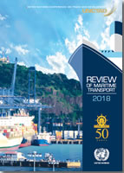
The RMT package
The RMT
… is complemented by:
On-line statistics http://stats.unctad.org/Maritime
Maritime country profiles 230 two-page summaries
Teaching and advisory services http://unctad.org/TLB
Blogs and quarterly news http://unctad.org/transportnews

