Slide 1
Have you ever heard of the National Trade Facilitation Committees (NTFCs)?

Slide 2
NTFCs = main implementers of the WTO TFA
20 million new jobs
$1 trillion
Trade gains
2/3 gains
Developing Countries

Slide 3

Opportunities and challenges for public –private coordination in trade facilitation reforms
P166 Short Courses
Geneva, Switzerland
12 October 2018
Pamela UGAZ
Trade Facilitation Section
UNCTAD
pamela.ugaz@un.org

Slide 4

Target
Why do we need public-private coordination?
What are the best practices?
How could Geneva-based missions support the work in capital ?

Slide 5

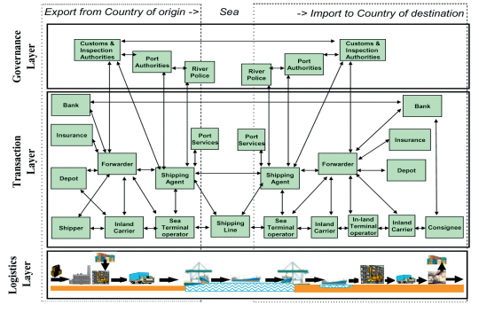
INTERNATIONAL TRADE: A MULTITUDE OF STAKEHOLDERS AND PROCEDURES
27 entities
274 working hours of paperwork

Slide 6
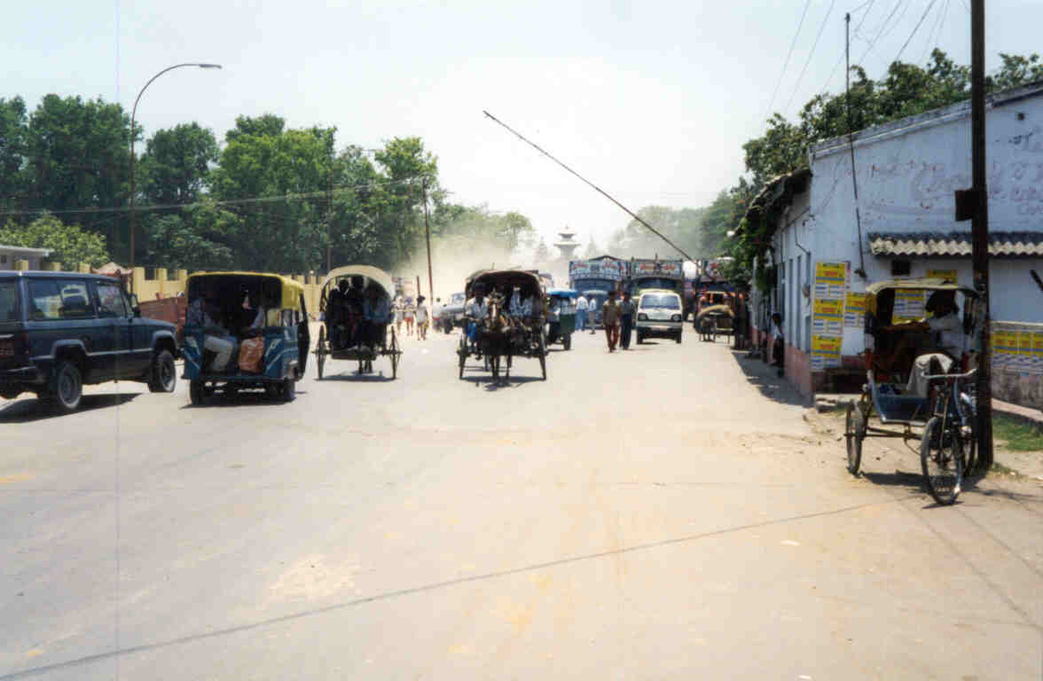
Poor organization at
Border crossings

Slide 7
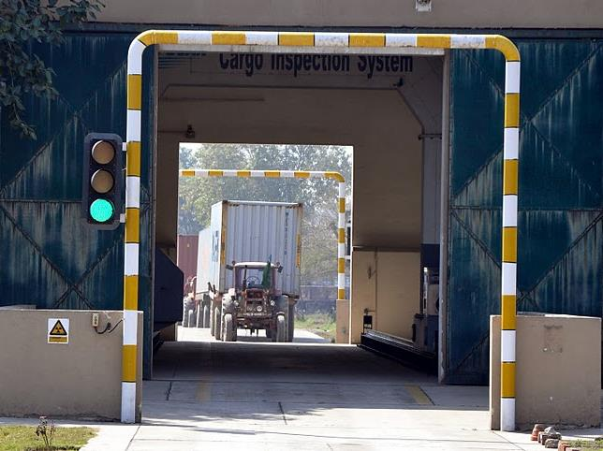
SECURITY CONTROLS
CONFORMITY CONTROLS

Slide 8
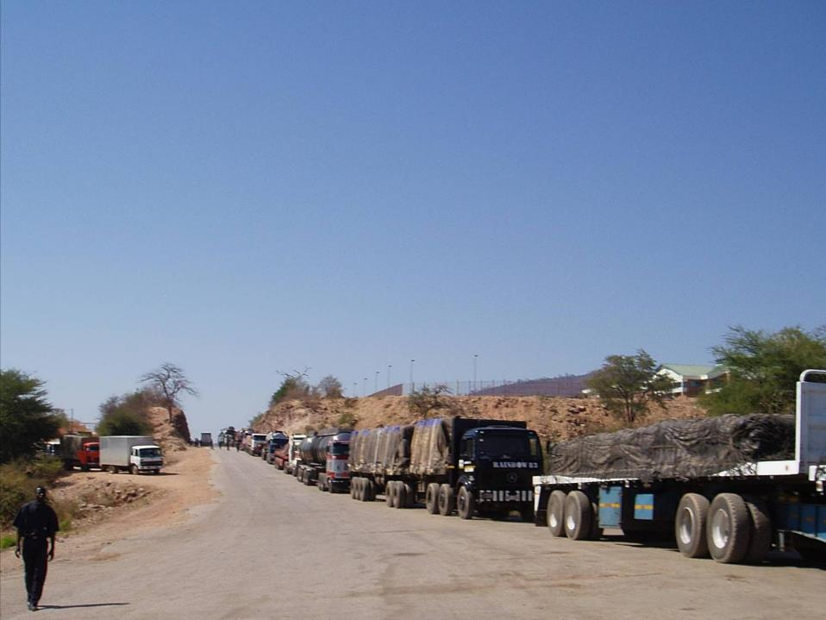
DELAYS AT BORDER CROSSINGS

Slide 9
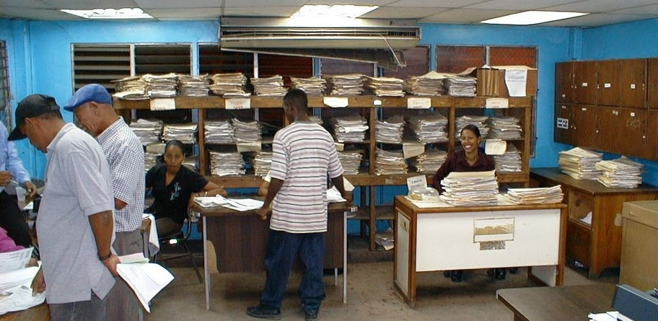
TOO MANY DOCUMENTS

Slide 10
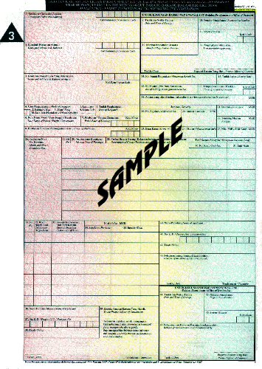

WHAT IS THE COST OF ADMINISTRATIVE BOTTLENECKS AND TRADE TRANSACTIONS?
Red tape and administrative barriers accounts for up to 75% of delay of shipments
Each additional day of delay can reduce trade volume by at least 1% (World Bank)
Costs of paperwork account for 3.5 – 7% of goods value (OECD). It can be as high as 10 – 15% (UNCTAD).

Slide 11
Solution: Trade Facilitation
Alignment of national procedures, operations and documents with international conventions, standards and practices.
Collaboration between public and private sector
Process of eliminating all unnecessary elements and duplications in formalities, processes and procedures
Harmonization
Simplification
Standardization
Process of developing internationally agreed formats for practices and procedures, documents and information.

Slide 12
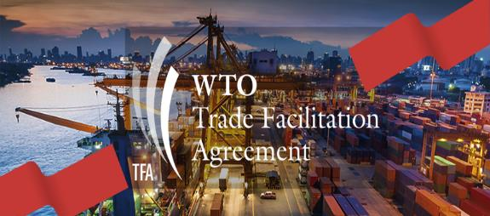
There are many conventions, international recommendations,
best practices but they are not binding until …
TFA
Section I – Substantive Provisions
Section III – Institutional arrangements and final provisions
Section II – Special and Differential Treatment
What is the newcomer in the trade facilitation field?

Slide 13
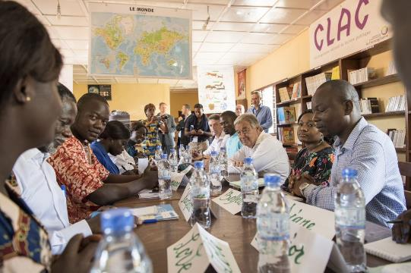

CNFC
Art 23: National Trade Facilitation Committees facilitate:
Internal coordination
Implementation of the TFA
Multi-agency permanent platform where relevant stakeholders from the public and private sectors discuss and coordinate trade facilitation measures at a national level.
NTFC = ”binding obligation"
No categorization
Must be implemented upon entry into force of the TFA

Slide 14
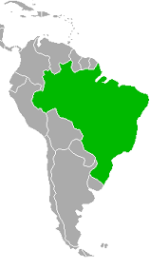


Public-Private partnership in Border processes modernization
Private initiative: 190 businesses and + 30 business associations
Participation: Customs and Min. Trade
Businesses: Knowledge + financial support
Achievements 2011-2014:
51 Detailed Business Process maps
Simplification plans: Export and import procedure
Benefits:
Customs: Knowledge ofbusiness processes
Private Sector: Influencing public policy in a positive way

Slide 15
Target
Why do we need public-private coordination?
What are the best practices?
How could Geneva-based missions support the work in capital ?

Slide 16

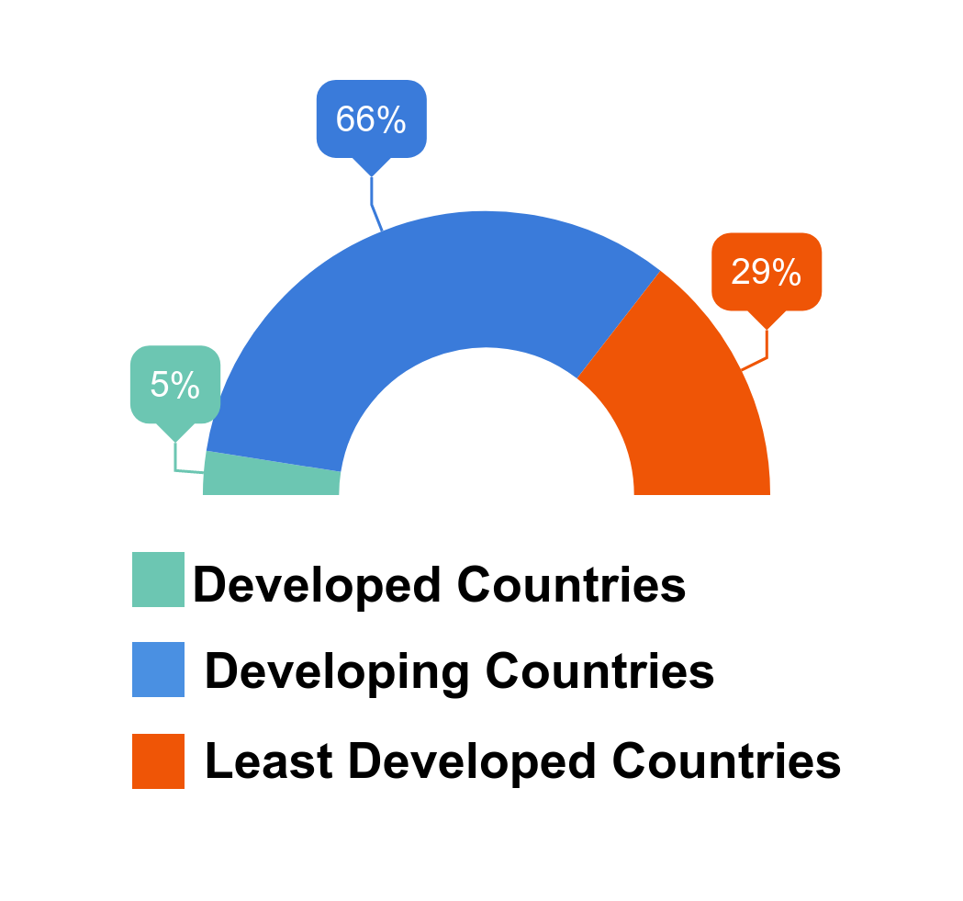

- UNCTAD Study 2015
- UNCTAD Study 2017
- Survey to 59 NTFCs
- LDC, Developing and developed countries

Slide 17
OBJECTIVES

Slide 18
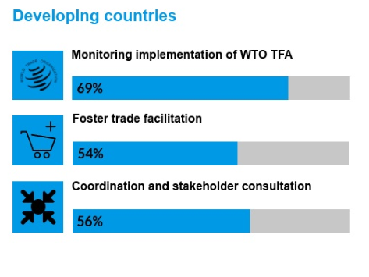
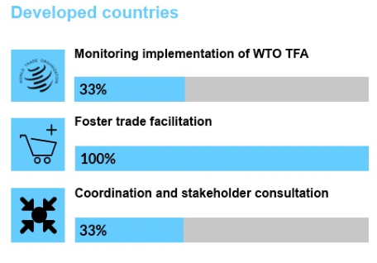
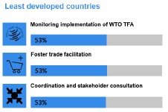
OBJECTIVES
NTFCs should address issues and goals beyond the WTO TFA

Slide 19
SCOPE

Slide 20
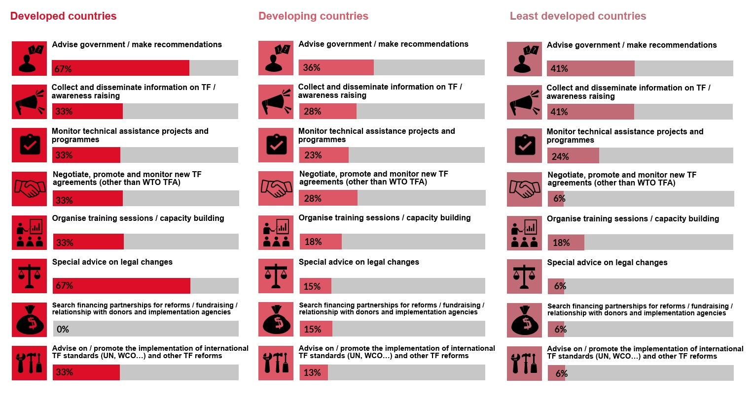
SCOPE
New scope of action

Slide 21
Formality

Slide 22
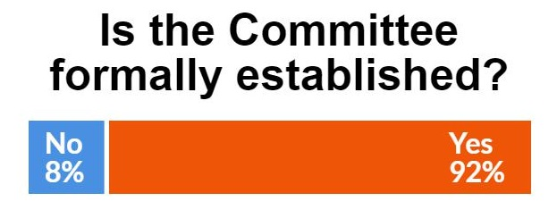
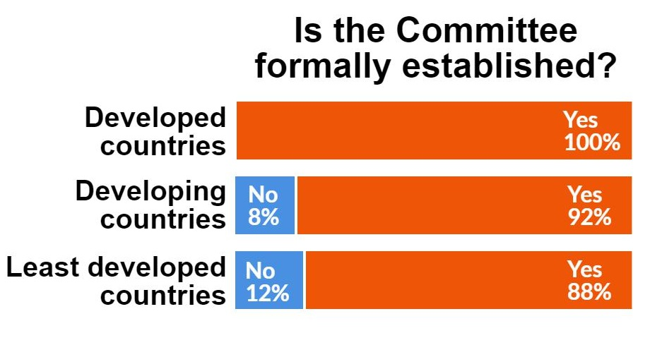
-Strong correlation between the degree of institutionalization and the sustainability of TF bodies.
-Advantages:
-preventing blockage
-Ensuring political will
16% more than 2015
Positive impact of the WTO TFA

Slide 23
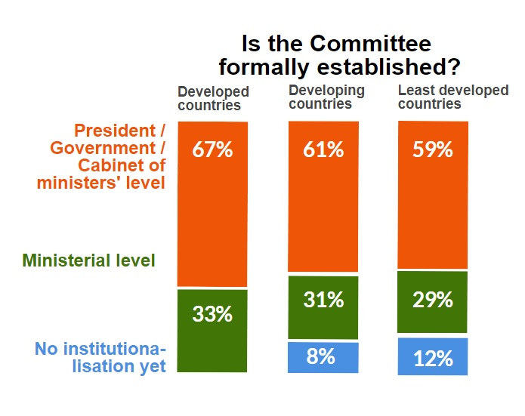
How was it established?
The less developed a country, the higher the level of the authority institutionalizing the trade facilitation body.

Slide 24
COORDINATING AGENCY

Slide 25
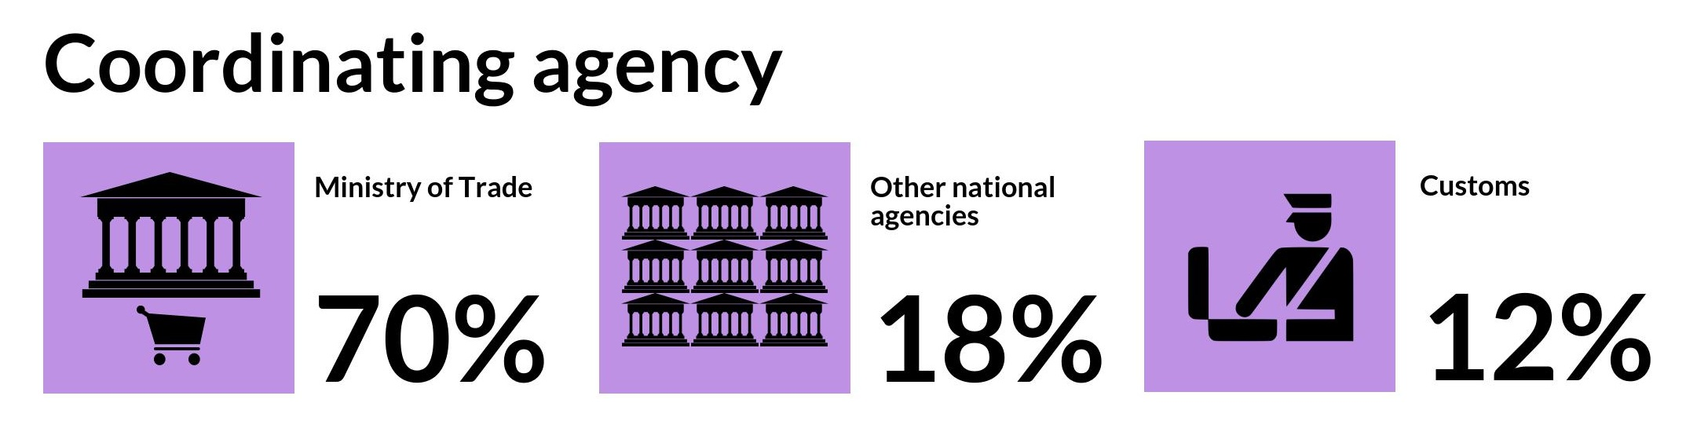
COORDINATING AGENCY
Leads the work of the Committee
Chairperson or vice- chairperson
i.e. Prime Ministry office, Ministry of Transport, Ministry of Foreign Affairs, etc

Slide 26
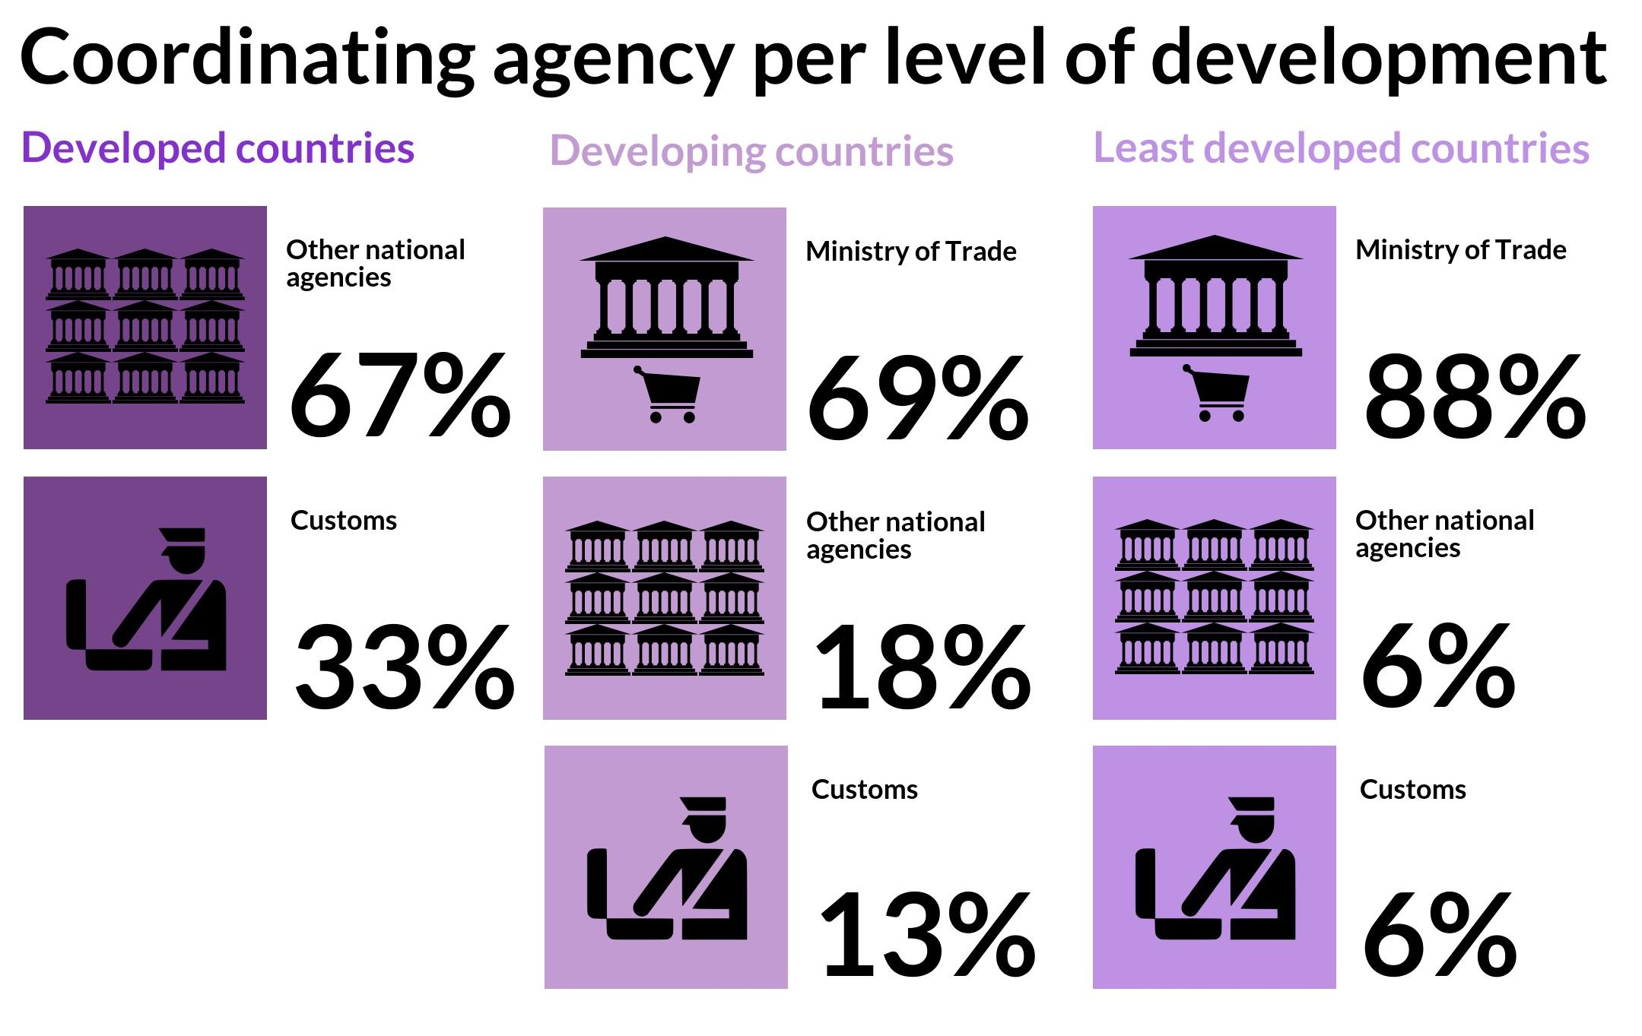
Per region:
Africa: 90% - Ministry of Trade
Asia: 27 % - Customs Authorities

Slide 27
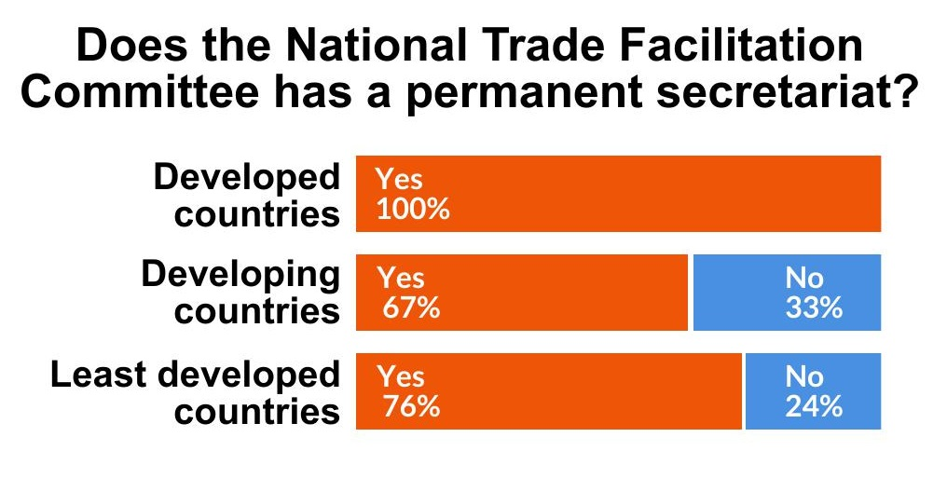
Has your NTFC a permanent secretariat?
Recommendation :
Provide the national trade facilitation body with a permanent secretariat.
UNCTAD 2015 Study- 50% LDCs counted with a Secretariat
26% increase in LDCs rate

Slide 28
MEMBERSHIP

Slide 29
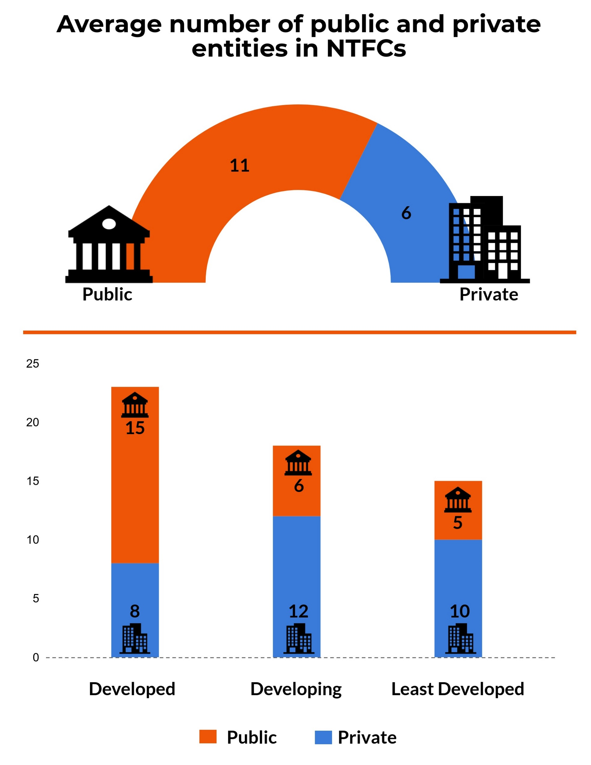
Recommendation :
Be inclusive – trade facilitation is a cross-divisional and cross-sectorial endeavour.
… and bring the private sector on board
Positive correlation between level of development and number of members
Average Membership: 17

Slide 30
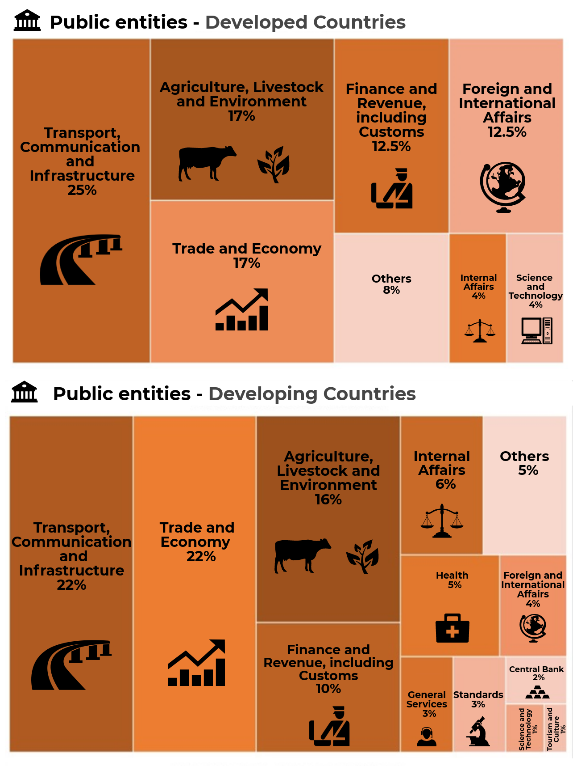
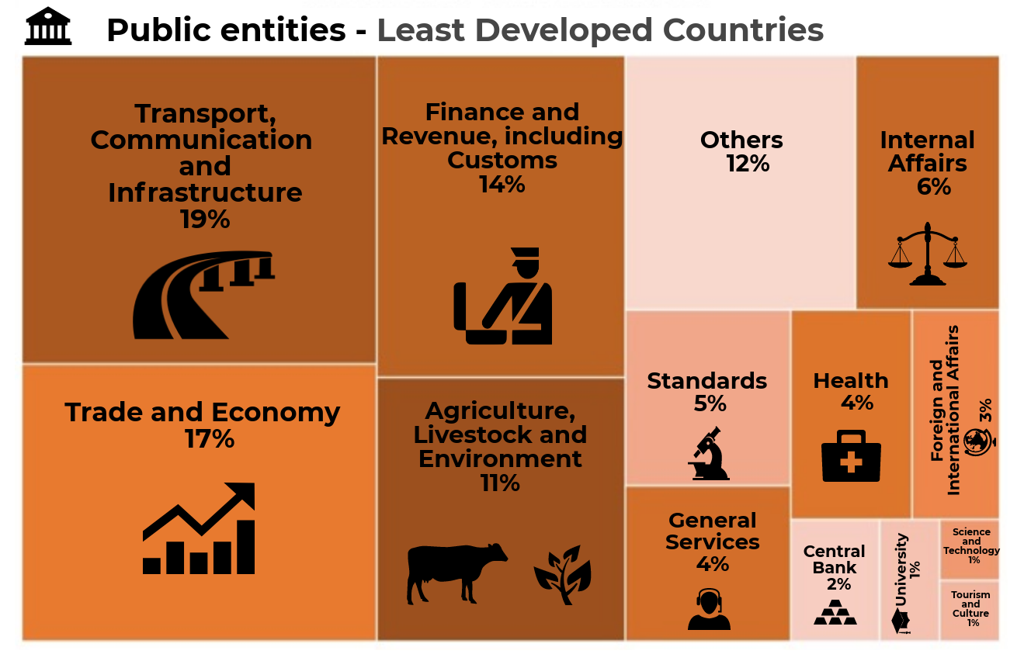
The less developed a country is, the more diverse the membership of an NTFC might be

Slide 31
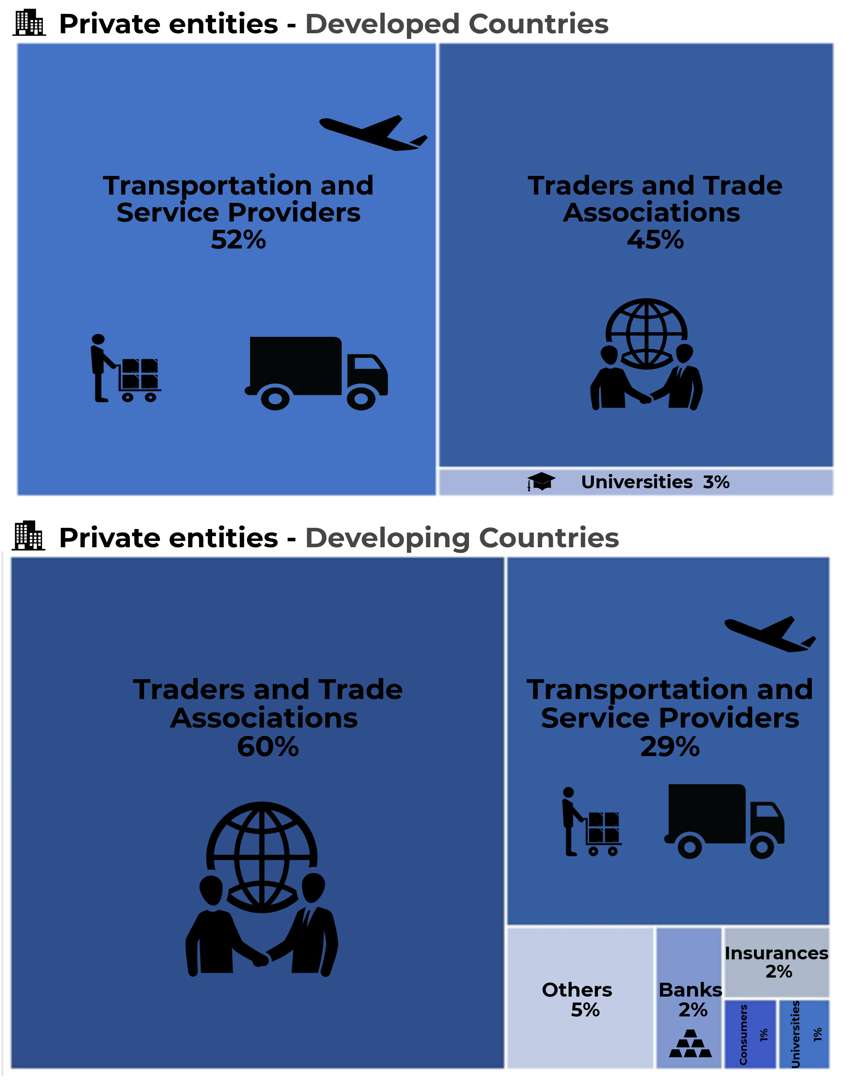
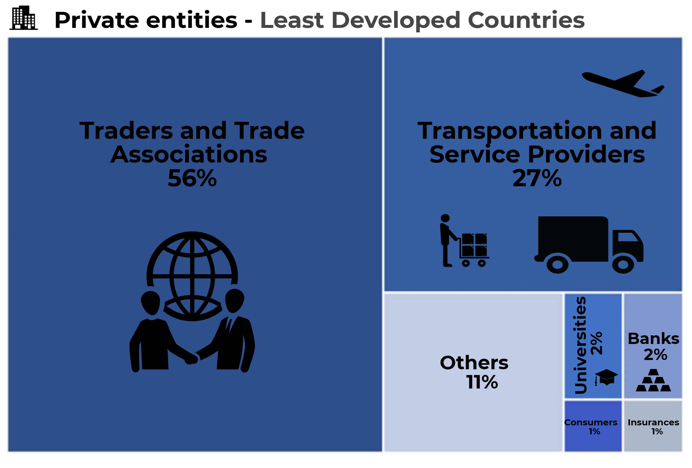
Traders and trade associations are more represented in developing and least developed countries

Slide 32
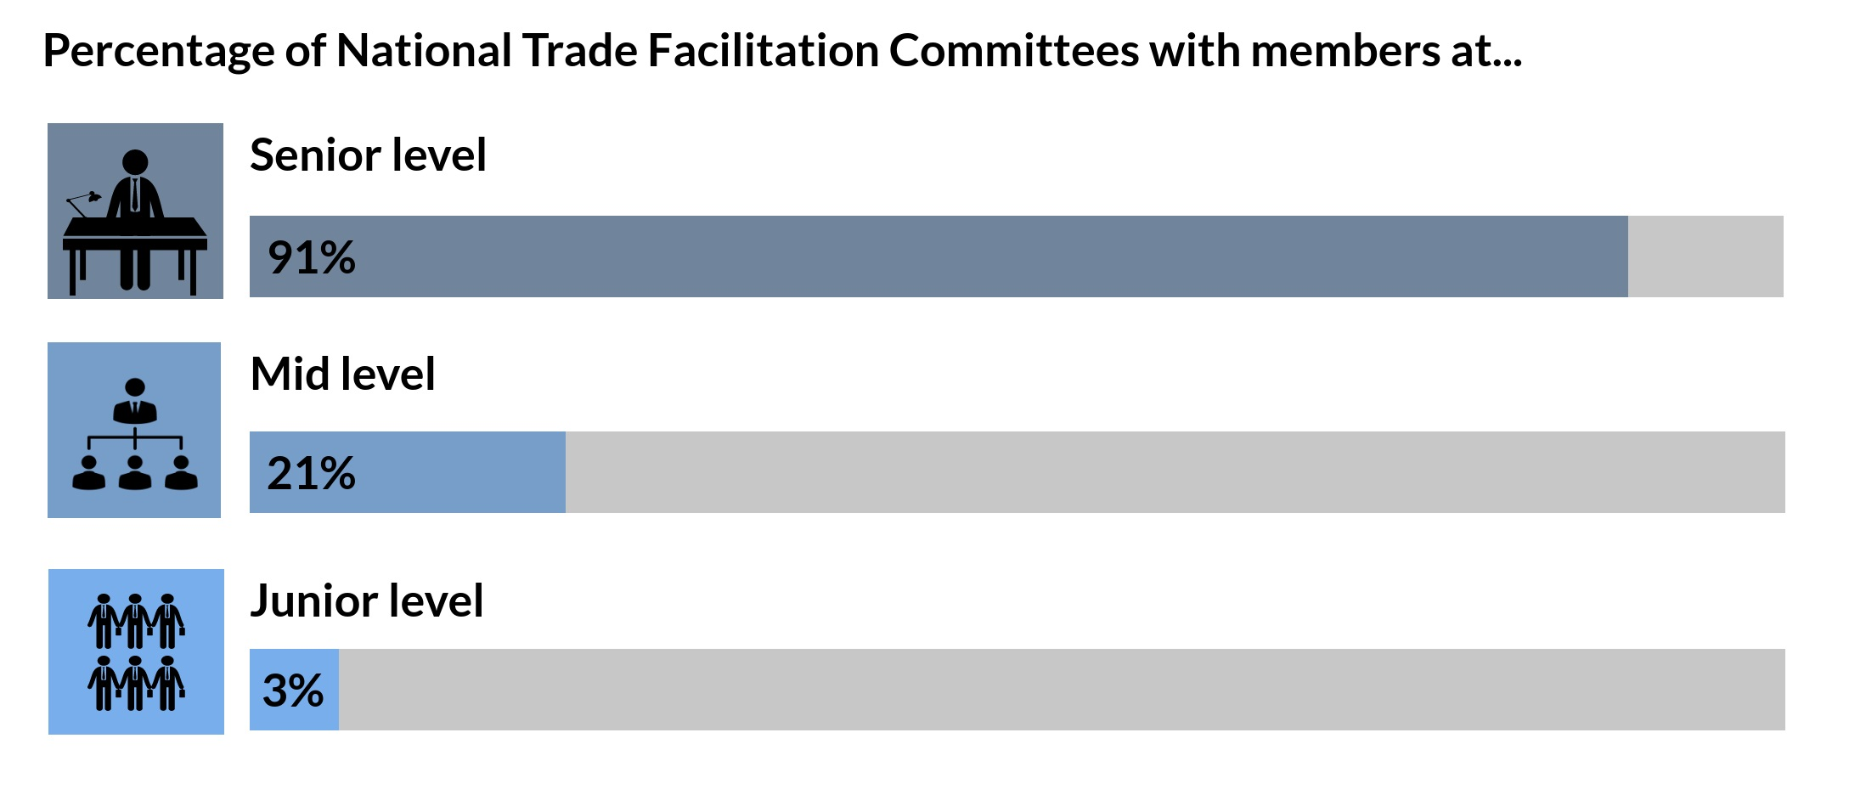
SENIORITY
Note
NTFCs = decision making bodies
Knowledgeable members
Decisional power

Slide 33
COMMUNICATIONS AND PROMOTION

Slide 34
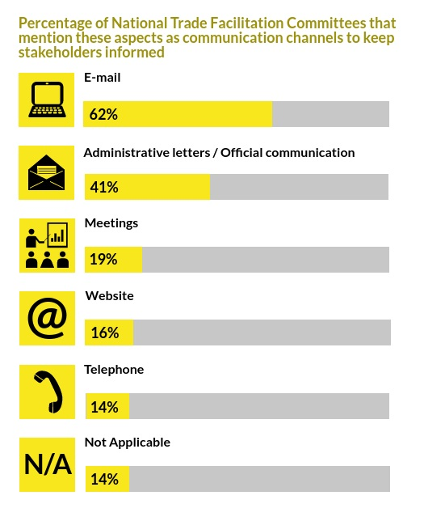

Two types of communication:
- Internal
- External
Note
What is the new tool used to communicate faster?

Slide 35
FINANCING

Slide 36
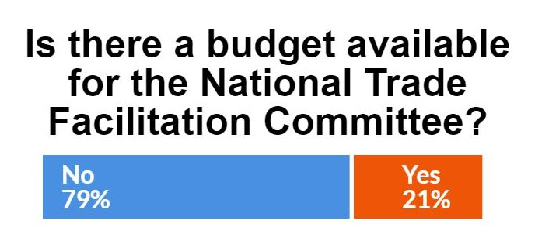
Recommendation 8:
Provide the national trade facilitation body with the necessary resources.
NTFCs’ financing is crucial for their sustainability. Many trade facilitation bodies were in operation while financially supported by donors, but dissolved once such funding ceased.

Slide 37
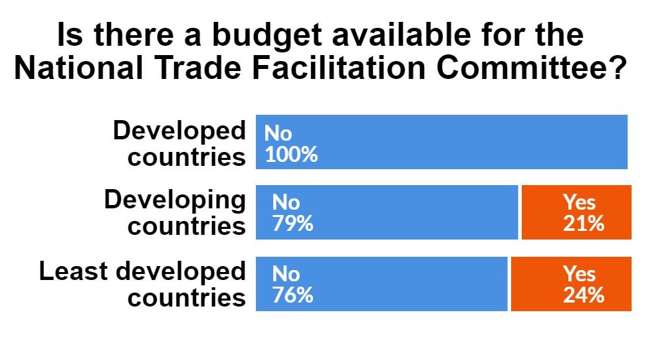
The level of development is not determinant for the availability of the budget

Slide 38
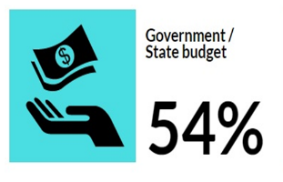
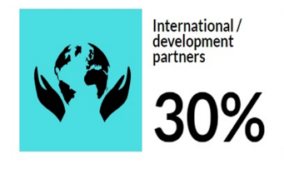
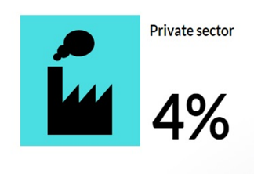
Sources of funding
Is it convenient that source of funding comes from international partners?
Temporary
Conditional
Non-sustainable

Slide 39
GENDER

Slide 40
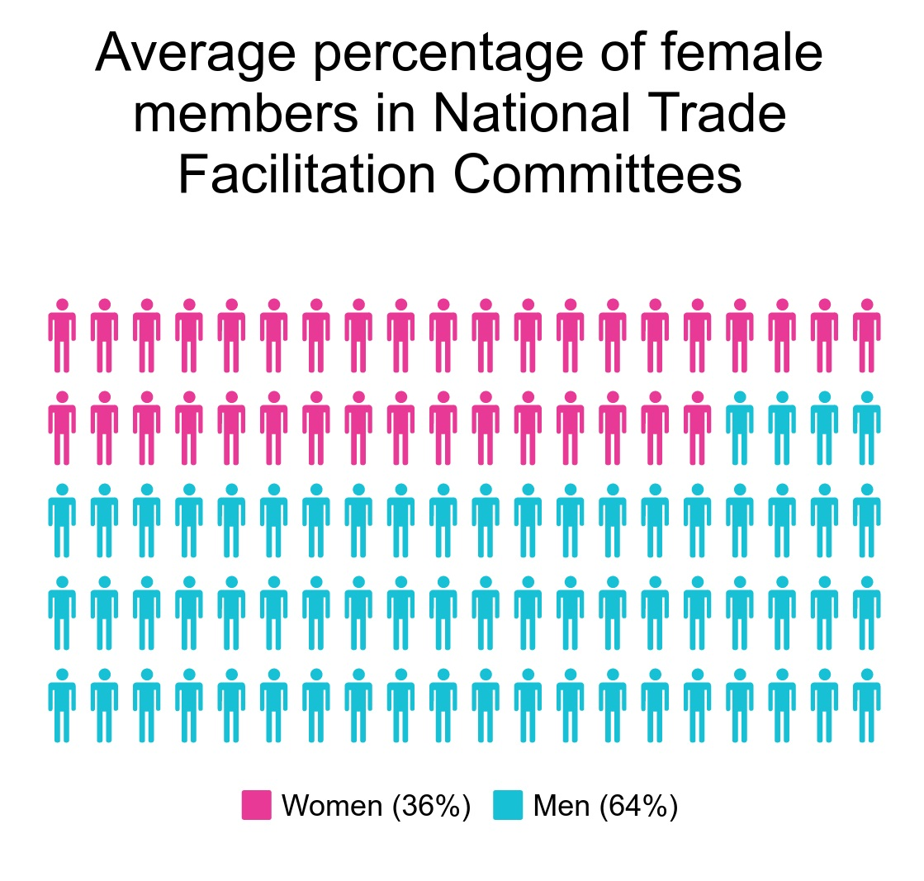
NTFCs are not gender balanced

Slide 41
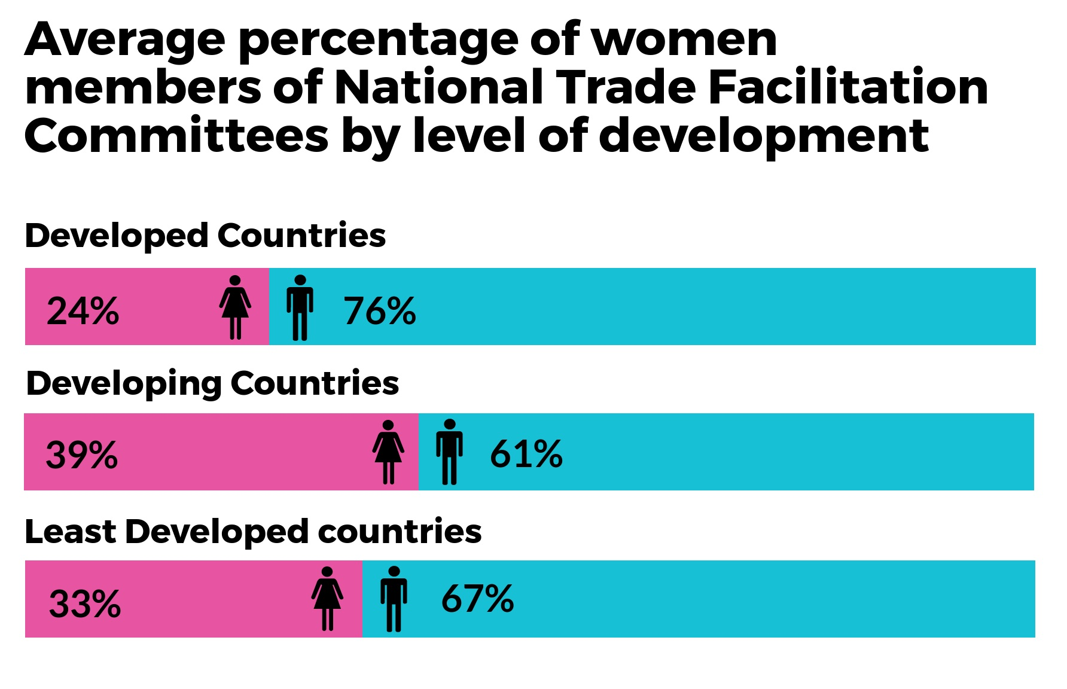
Chairperson:
62 % are chaired or co-chaired by men

Slide 42
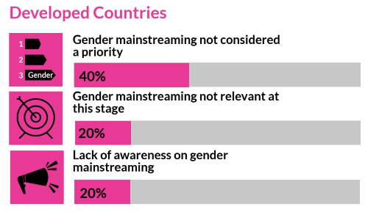
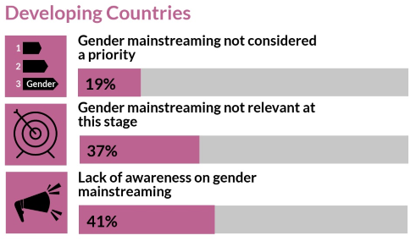
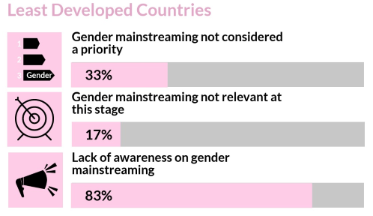
Reasons per level of development

Slide 43
Sharing lessons

Slide 44
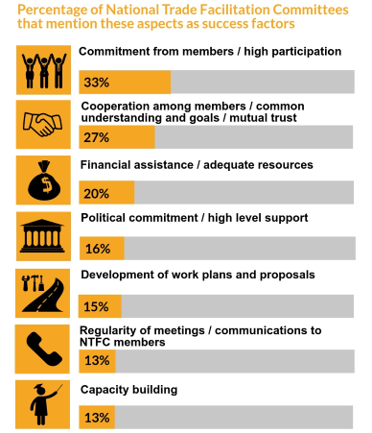
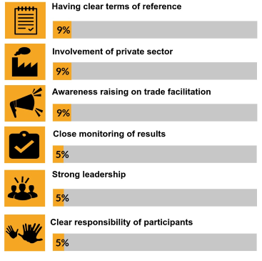
SUCCESS FACTORS

Slide 45
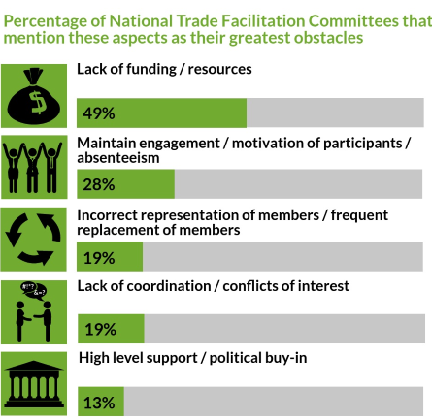
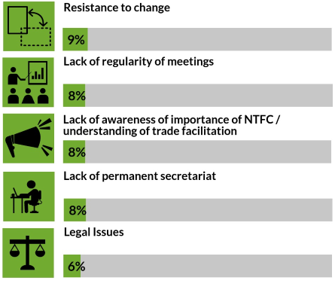
MAIN OBSTACLES

Slide 46
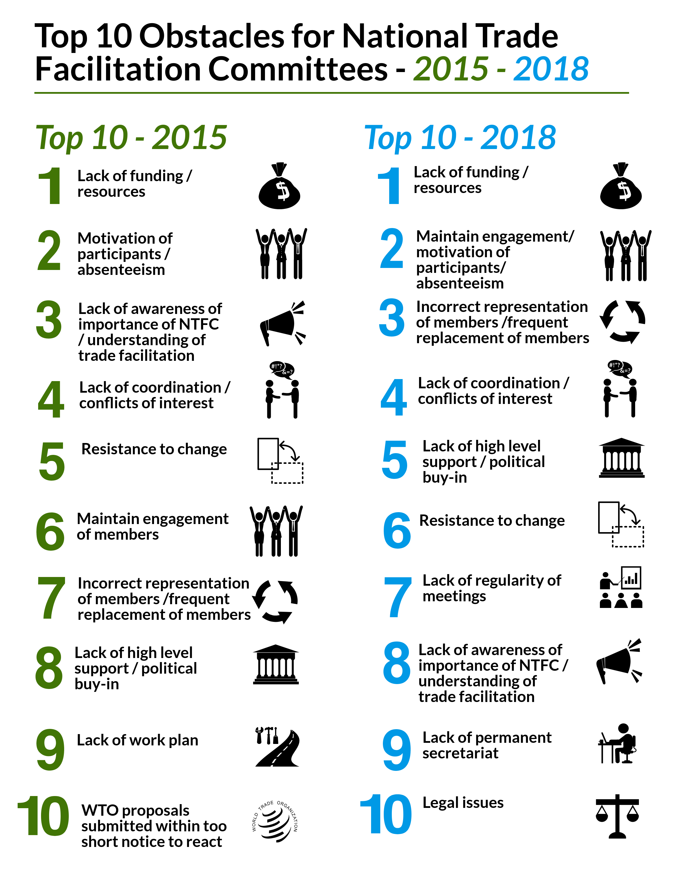
New
New
New

Slide 47
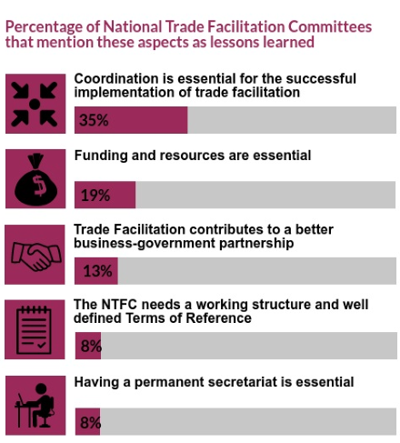
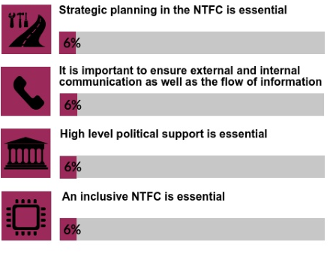
LESSONS LEARNED

Slide 48
Target
Why public-private platforms?
What are the best practices?
How could Geneva-based missions support the work in capital ?

Slide 49

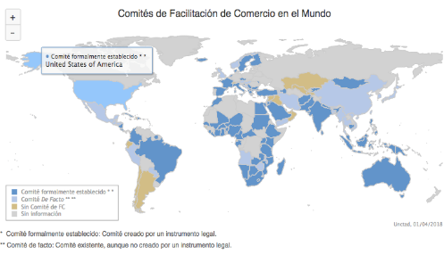
UNCTAD NTFC repository
Connecting and Communicating
Intensive Courses
Members of the Committee and the Secretariat
One year
Certification
http://unctad.org/tfcommittees
More than 90 NTFCs
5 continents
Best practices
http://unctad.org/tfcommittees

Slide 50
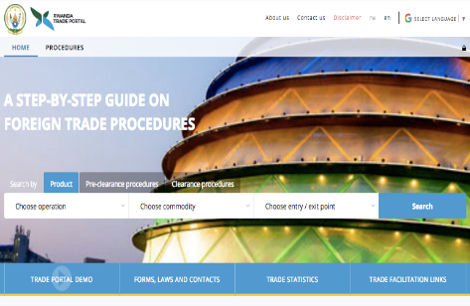
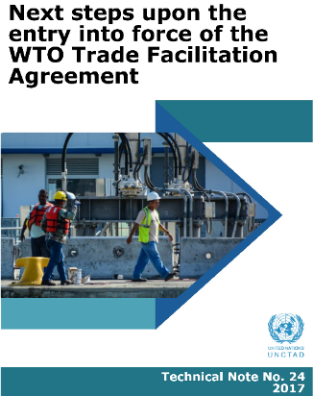
Trade portals
35 Electronic Portals
2.993 processes documented online
80% reduction in procedures and documentation
http://tradeportal.eregulations.org
And more
Implementation Plans
National Trade Facilitation roadmaps
Technical assistance in specific measures
http://unctad.org/tf

Slide 51












Take away: TF relevant for developing countries
Economic Relevance
Costs
Diversification
SMEs
Revenues
FDI
Human Development Relevance
S&T Relevance
Self-determination
Compliance
Technical Assistance & Capacity building

Slide 52
Thank you!
Pamela Ugaz
Trade Facilitation Section pamela.ugaz@un.org http://unctad.org/en/DTL/TLB/Pages/TF/Committees/default.aspx http://unctad.org/en/DTL/TLB/Pages/TF/Committees/Empowerment-Programme-for-National-Trade-Facilitation-Bodies.aspx

