Slide 1

Gender and trade within the
2030 Agenda for Sustainable Development
Geneva, 2nd November 2018
Trade, Gender and Development Programme
Division on International Trade and Commodities (DITC)
Prosperity for all

Slide 2
OUTLINE
The many facets of inequality
Why promote gender equality
The trade and gender nexus
  The first side of the equation: Gender affects trade
  The other side of the equation: Trade affects gender
The new global frameworks
  The 2030 Development Agenda
  The Addis Ababa Action Agenda
New initiatives by the trade community
  Trade Impact Group (IGC)
  The Buenos Aires Declaration
  Trade and gender in trade agreements
  Gender assessments and gender data

Slide 3



The many facets of inequality: Women…
Are less like to have a job than men: in 2017 LFP rate of men 75%; women 50%
Spend more time on housework and care work and much less time on market than men
Represent two-third (505 million) of adults who can not read or write (758 million). Young women aged 15-24 are making the strongest gains, but still lag behind young men
Work in fewer sectors than men
Earn less than men: on average 20% less
Constitute 24% of the members of parliaments
More likely to be found in low-productive, vulnerable and informal jobs
Over 2.7 billion women are legally restricted from having the same choice of jobs as men
Notes:
Are less like to have a job than men: in 2017 LFP rate of men 75%; women 50%
Work in fewer sectors than men
Earn less than men: on average 20% less
More likely to be found in low-productive, vulnerable and informal jobs
Represent two-third (505 million) of adults who can not read or write (758 million). Young women aged 15-24 are making the strongest gains, but still lag behind young men
Spend more time on housework and care work and much less time on market than men
Constitute 24% of the members of parliaments
Over 2.7 billion women are legally restricted from having the same choice of jobs as men

Slide 4
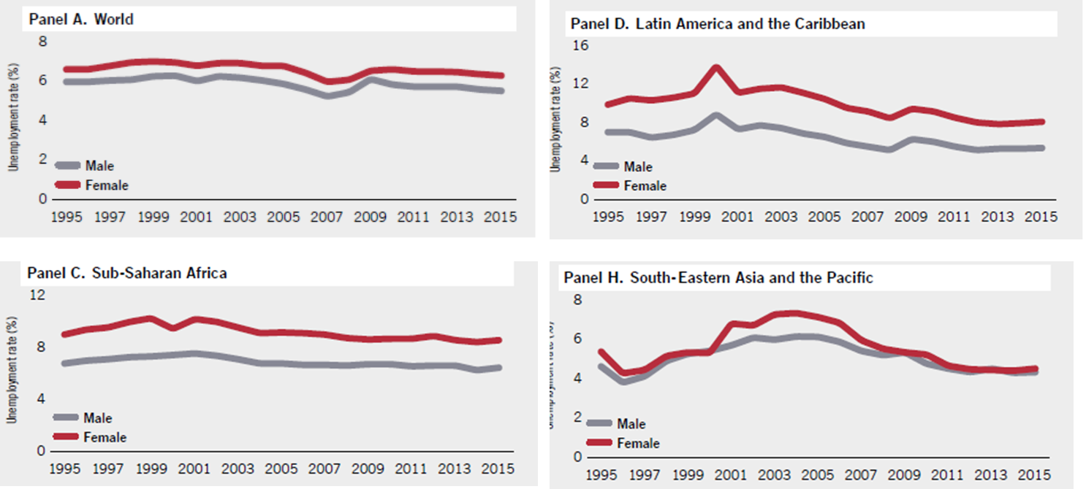
Women are less likely to have a job than men: Unemployment rates by sex and by region
Why? Temporary contracts; educational attainment; labour market segregation; household chores
Source: ILO, Global Employment Trends for Women, 2016

Slide 5


Slide 6
Labour market segregation
Men and women work in different sectors & occupations, often according to social norms
  It limits the extent to which women benefit from and can contribute to economic growth
  It prevents the efficient allocation of labour with negative consequences for productivity & income distribution
  It contributes significantly to gender wage gaps
  It reduces the ability of labour markets to respond to shocks

Slide 7
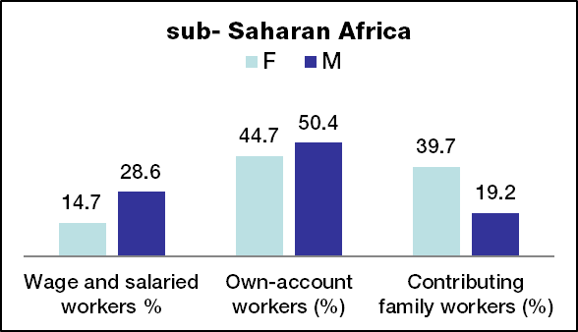
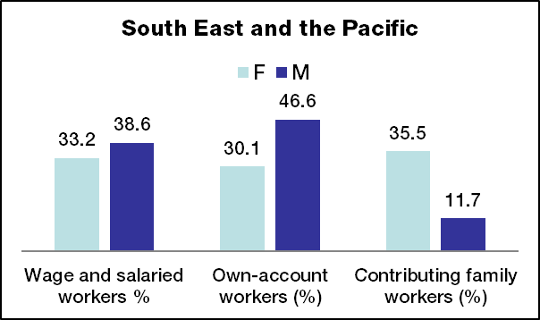
Which kind of employment do women have?
Source: ILO (2012)

Slide 8
Unpaid work and time poverty
In all countries, women do the bulk of unpaid work and are the main providers of care to children, the elderly and the sick
  Difficulties in entering or maintaining formal, waged labour
  Women assigned to low-paid, low status jobs, such as home-based work
  Limited opportunities to gain new skills
  Double burden → care work critical to the survival of the economy and society
time poverty

Slide 9
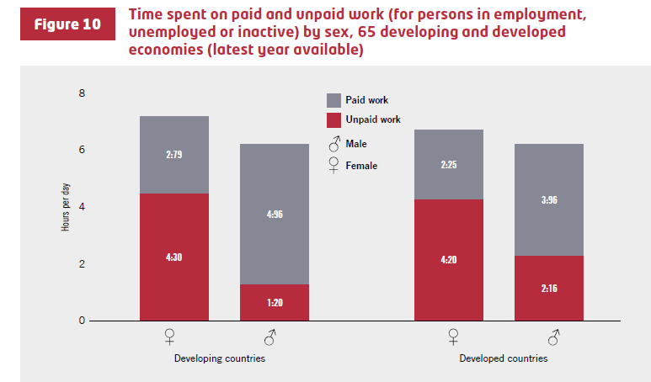

Slide 10
The Gender Wage Gap
The difference between male and female earnings expressed as a percentage of male earnings
Globally estimated at 20%: women earn 80% of what men earn
Gender wage differentials may be due to a variety of factors, including:
  Crowding of women in low paying sectors/occupations
  Differences in skills and work experience
  Residual/unexplained component: discrimination
The gender wage gap is not narrowing enough despite rapidly narrowing gender educational gaps→ at current trends, it will take 70 years to close it.

Slide 11

Why promote Gender Equality?
A moral challenge
A drag on growth
Equality between men and women is a human right
Women play a fundamental role in development, reducing inequalities will have overall beneficial consequences
Economic development can play an important role to bridge inequalities
Economic development is not enough to reach gender equality
Policy action in necessary to accelerate this process
Gender equality improves when poverty declines

Slide 12

Mckinsey Global Institute: The Power of Parity 2015
In a full-potential scenario in which women play an identical role in labor markets to men’s, as much as $28 trillion, or 26%, could be added to global annual GDP in 2025
If all countries were to match the progress toward gender parity of the best performer in their region, it could produce a boost to annual global GDP of as much as $12 trillion in 2025
equivalent to the current GDP of the US and China combined
equivalent to the current GDP of Japan, Germany, and the UK combined

Slide 13
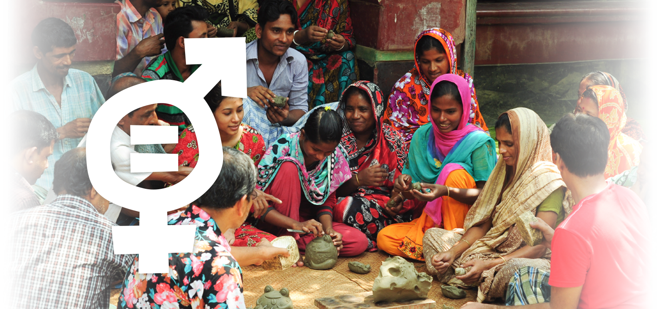
The Trade and Gender Nexus

Slide 14
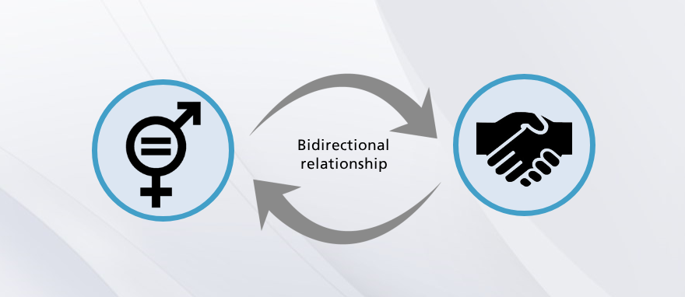
Two-way relationship
The economy as a gendered structure:
part of a system shaped by gender relations/biases
1.Identifying gender-based inequalities across domains
2. Recognize unpaid work that women do
Notes:
1. As we shall see, gender inequalities such as the gender wage gap, women's lower bargaining power and gender norms and stereotypes can sometimes enhance the cost competitiveness and exports of firms.
But they can also negatively impact the ability of trade policies to deliver the desired economic results.
2. Gender biases underpin the economic system. Understanding the economy as a “gendered structure” implies viewing the economy as part of a system deeply shaped by gender relations, while identifying gender-based distortions that influence labour markets and the distribution of resources such as assets or time.
That is, the economy is part of the system of social relations in which gender is already inscribed
The first step in looking at the economy through a gender lens is to make visible the unpaid household work and care work that women are primarily responsible for due to long-standing gender norms. This unpaid labour is vital for the continued functioning of the market-oriented economy.
The second step of a gender-aware analysis is to identify and analyze how gender bias operates and affects women in the multiple roles they play in the economy.
Gender inequality can be measured through a number of different indicators:
(a) the capabilities domain of indicators that measures basic human abilities such as education and health;
(b) the access to resources and opportunities domain of indicators that measures for instance, land ownership, income and employment as well as women's share of leadership positions;
(c) the security domain of indicators that measures vulnerability to violence and conflict, including rape and harrassment.

Slide 15
1. Gender inequalities → impact on trade
Gender-based inequalities can impact significantly on trade outcomes and performance:
a.
Gender inequality as a growth strategy
b.
Gender inequality as a burden on countries’ competitiveness
Notes:
Let's first look at the first side of the equation: how can gender inequalities have an impact on a country's trade performance and competitiveness?

Slide 16
a. Gender inequalities as a growth strategy
Women are hired by firms in labour intensive export industries to cut labour costs due to lower wages of female workers
  Gender wage gap leveraged to improve international competitiveness
  Gender norms and stereotypes about women's "nimble fingers", dexterity, docility, attention to detail and reluctance to join unions
  "Feminization of labour" in labour-intensive segments of manufacturing (textiles, garments, clothing, toys and electronics, particularly in EPZs)
Women as a source of competitive advantage
Notes:
Gender inequalities can be exploited to the advantage of firms' competitiveness in several ways
Women in general receive relatively lower pay for similar work as compared to men due to discriminatory norms and practices across the world
they are hired by firms that face stiff competition in the international market in order to cut labour costs
This phenomenon has led to a "feminization of labour" in the labour-intensive segments of manufacturing, such as textiles, garments, clothing, toys and electronics, particularly in export processing zones (EPZs)
Gender norms and stereotypes about women's "nimble fingers", dexterity, docility, attention to detail and reluctance to join unions has created the myth that women are particularly suited for labour-intensive work and this has also facilitated their entry into light export oriented manufacturing

Slide 17
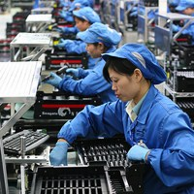
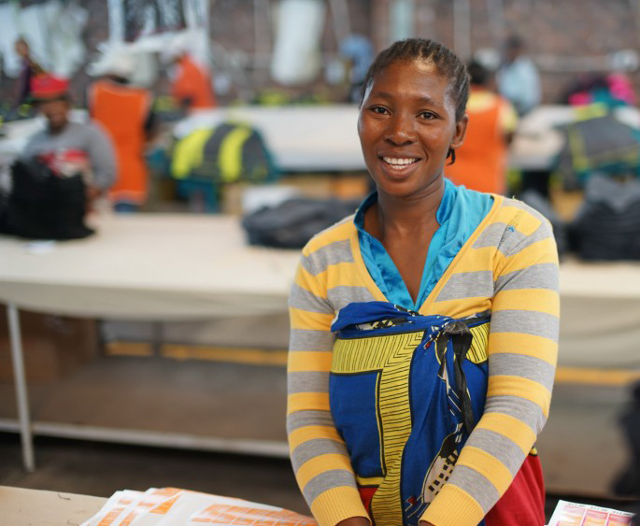
An example
E.g. Taiwan used labor intensive manufacturing to build export competitiveness with significant implications for women's employment.
E.g. In Africa, Lesotho successfully used the US Africa Growth and Opportunity Act (AGOA) in order to build a competitive edge in apparel exports, a sector that employs a large number of women.

Slide 18
b. Gender inequality as a burden on countries' competitiveness
Due to the various types of gender inequalities they face, women often are not competitive as small entrepreneurs or self-employed producers
Women’s limited efficiency affects the sector/country’s export competitiveness → the economy is unable to release its growth potential
Women are responsible for food and children's education: diminishing women's opportunities affects not only their living conditions but the livelihoods and future prospects of many more
Women as underachievers of competitive advantage
Notes:
At the same time, due to the various types of gender inequalities they face, women often are not competitive as small entrepreneurs or self-employed producers. Such gender specific obstacles that hold back women's productivity and their entrepreneurial potential may indirectly hinder trade performance
→ gender inequalities can be divided into three domains: capabilities, access to resources and opportunities, and security. Poor health, lack of information and training, lack of access to credit, limited land ownership, and vulnerability to violence and harassment can prevent women from scaling up their productive activities, taking advantage of export opportunities and achieving their economic potential.

Slide 19
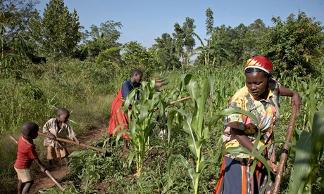
An example
Gender gaps in land, assets, inputs, and technologies have a high opportunity cost in terms of gains in yields, production, and potentially, reduction in hunger
E.g. In Rwanda most women are employed in subsistence agriculture and have limited control over land due to traditions and customary laws. Levels of illiteracy in rural areas are also high.

Slide 20
2. Trade → impacts on gender inequalities
Trade may impact women in the various dimensions of their lives:
Changes in the structure of production
Changes in the relative prices
of goods and services
Reduction in
tariff revenues
Wage workers
Producers
Consumers
- imported products
-public services
Notes:
We have already analyzed the first side of the equation and explained how gender inequalities may positively or negatively affect trade performance. Let's now explore the other side of the equation: how does trade affect gender?
a. Trade may lead to changes in the structure of production, with sectors producing for export expected to expand and other sectors sensitive to competition through imports expected to contract. This, in turn, causes changes in the level and distribution of employment of different categories of workers, including men and women.
b. Trade induces changes in the relative prices of goods and services and changes in real incomes that affect groups differently, depending on their consumption patterns and livelihood strategies.
c. Trade openness is also likely to reduce tariff revenues, and this, in turn, may have gender-specific effects on the size and composition of government expenditure.

Slide 21
Women as wage workers
Trade expansion causes changes in the structure of production of a country: some sectors expand, some sectors contract
  Women can benefit from trade liberalization if they are active in sectors that expand. But what is the quality and security of their employment? In which sectors? (e.g. Lesotho)
  Women can lose from trade liberalization if employed in sectors that contract (import-competition)
Gender roles in the households and labour markets are rather rigid→ women are less likely to enter expanding non-traditional female sectors because of limited access to productive resources and training, and time constraints

Slide 22
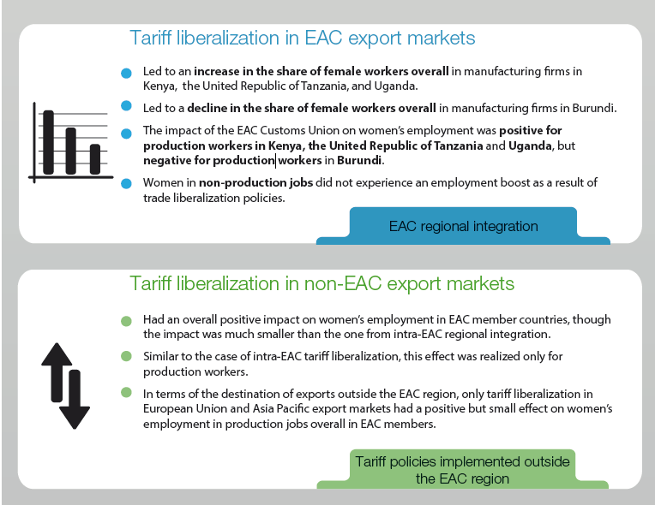
An example

Slide 23
Women as producers and traders
Trade liberalization increases competition from imported goods:
  displace women as producers or farmers;
  negatively hit women selling local products;
However, it also allows to buy cheaper goods to resell on the market:
  E.g. in Angola, women in urban areas trade cheap imported goods informally (oil-induced growth crowded out other productive activities)
Creates export opportunities and leads to higher prices of export goods, yet women traders have greater difficulty in accessing export markets:
  In the Gambia, women in the fisheries sector are small-scale traders who buy and sell fresh produce locally while men predominate in exports of frozen and smoked fish and commercial fishing

Slide 24
Women as consumers of imported goods and consumers of public services
Women are more affected than men by changes in the relative price of basic consumption goods - an important component of their consumption basket
  E.g. In Cape Verde, the elimination of tariffs on food products positively impacted the welfare of female-headed households who spend a larger share of their income on food
Reduced tariff revenues:
  Reduced public spending on essential services (health/education) → Increased burden on women

Slide 25
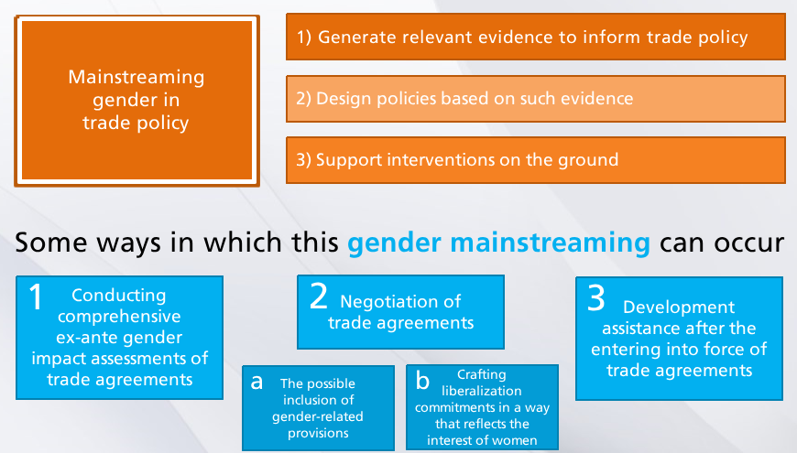

Slide 26

The new global frameworks

Slide 27

The 2030 Development Agenda
Gender priorities included in a bolder manner (economic, political and social aspects) compared to MDG
Gender-specific indicators are included throughout the SDGs
SDG 1 - Ending poverty
SDG 2 - Ending hunger
SDG 3 - health and well-being
SDG 4 - education
SDG 5 - Achieving gender equality and empowering women
SDG 8 - decent work and economic growth
SDG 11 - sustainable cities and communities
SDG 13 - climate action
SDG 16 - Promoting peaceful and inclusive societies
SDG 17 - global partnership
No explicit link between GEWE and trade
SDG 17 does not address the links between trade and overarching objectives, such as GEWE
Some SDGs are more "transformative" than others
Some SDGs may benefit from more attention and more financing
Notes:
The debate about the possibility of having gender priorities articulated in a stand-alone goal or rather mainstreamed into other goals across the agenda was a major focus of discussion in the definition of the 2030 Development framework.
Consensus was reached since the early stages that both approaches were necessary (Razavi, 2016).
addressing gender inequality as a key challenge that remains universal and that is a priority in itself.
a stand-alone goal on gender was considered to have a catalytic effect on the overall advancement of the broader development agenda,
granting the necessary visibility to a gender goal would more effectively promote the accountability of member states in this area.
On the other hand, integrating gender considerations in other areas of the new framework aimed to overcome the shortcomings of the MDG agenda.

Slide 28
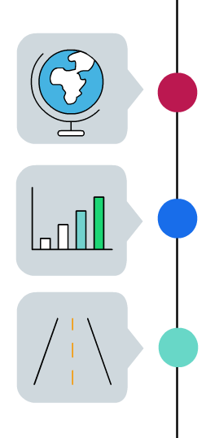
The Addis Ababa Action Agenda
Supports implementation of the 2030 Agenda; provides global framework for financing sustainable development by aligning financing flows and policies with economic, social and environmental priorities
GEWE
essential to achieve sustained, inclusive and equitable economic growth and sustainable development
helps promote productive employment, decent work, GEWE, food security, SDGs IF appropriate supportive policies, infrastructure, educated workforce in place
International trade
Notes:
Financing is considered key for the success of the new sustainable development agenda
The Addis Ababa Action Agenda was adopted at the Third International Conference on Financing for Development (Addis Ababa, Ethiopia, 13-16 July 2015) and subsequently endorsed by the UN General Assembly in its resolution 69/313 of 27 July 2015. The Action Agenda establishes a strong foundation to support the implementation of the 2030 Agenda for Sustainable Development.
It provides a new global framework for financing sustainable development by aligning all financing flows and policies with economic, social and environmental priorities. It includes a comprehensive set of policy actions, with over 100 concrete measures that addresses all sources of finance, and covers cooperation on a range of issues including technology, science, innovation, trade and capacity building.
Link between gender and trade are stronger in the AAAA than the 2030 agenda

Slide 29
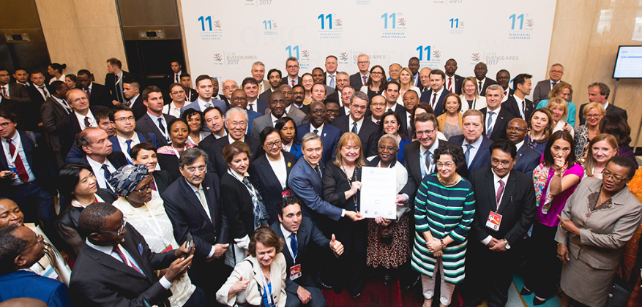
How the Trade Community is Addressing Gender Issues

Slide 30
Trade Impact Group (IGC)
Multi-stakeholder network within IGC - Permanent Missions, international organisations, civil society, the private sector, and academic research centres
International Gender Champions
Leadership network of decision-makers committed to gender equality in their spheres of influence (launched in July 2015).
205 active Champions - heads of International Organizations, Permanent Missions, and organizations from the civil society.
Pledges of UNCTAD's SG:
  Panel Parity Pledge to no longer sit on single-sex panels
  Foster gender equality in UNCTAD’s recruitment and promotions (New UNCTAD Gender Parity Strategy just launched)
  Mainstream gender in all of UNCTAD’s flagship publications and in UNCTAD’s technical assistance programmes

Slide 31
Buenos Aires Declaration on Trade and Women's Economic Empowerment
Declaration shows that collaboration through the International Gender Champions can have an impact far beyond the network
  Led by ITC, the Permanent Representative of Sierra Leone, and the Permanent Representatives of Iceland
  Joined by 121 members at MC11 in Buenos Aires
  Acknowledges that:
    inclusive trade policies contribute to advancing GEWE, which has a positive impact on economic growth;
    there's need to develop evidence-based interventions that address the range of barriers that limit opportunities for women in the economy.
Series of seminars going forward to the next WTO Ministerial Conference in 2019 to support the implementation of the Declaration
Notes:
Gender-Based Analysis of Trade Policy, Public Procurement, International Value Chains, Financial Inclusion, Digital Trade

Slide 32
Trade and Gender in trade agreements
Trade and gender chapters of the Chile-Uruguay FTA and the Canada-Chile FTA
  Recognise the importance of gender mainstreaming for achieving inclusive economic growth
  Provisions for cooperation (e.g. skills enhancement, financial inclusion, agency and leadership, entrepreneurship, technology and innovation)
Trade and gender chapters of the Canada-Israel FTA
  Chapter subject to the dispute settlement process.
EU Parliament resolution to include gender in trade agreements (e.g. provision under discussion for Chile-EC trade agreement)
Notes:
Gender-related considerations have started to be included in the text of FTAs
Increased awareness about the gender dimension of trade policy, as a result of advocacy campaigns and research work
The inclusion of trade and gender chapters in new FTAs is a welcome step:
they raise the profile of gender equality issues in the trade discourse
they encourage broader participation by civil society and the private sector in the implementation of agreements
they enhance cooperation between parties to the agreements on issues of immediate relevance to women

Slide 33
Th ex-ante gender impact assessment of trade reforms
Assessments prior to introducing new trade measures. UNCTAD developed a Trade and Gender Toolbox, a methodological approach for carrying out ex ante gender-impact assessments of trade reforms.
Higher demand for more comprehensive and gender-disaggregated data to better capture the trade-gender nexus and formulate the right policies
Gender data
Notes:
The toolbox has four main components:
Descriptive analysis of gender inequalities and the economic context of the country at stake.
Quantitative analysis of the expected consequences of the trade reform on the economy (e.g., exports, GDP, sectoral labor demand) and on women’s participation in the economy in particular.
A checklist for gender-sensitive accompanying measures and monitoring indicators.
A Trade and Gender Index.

Slide 34
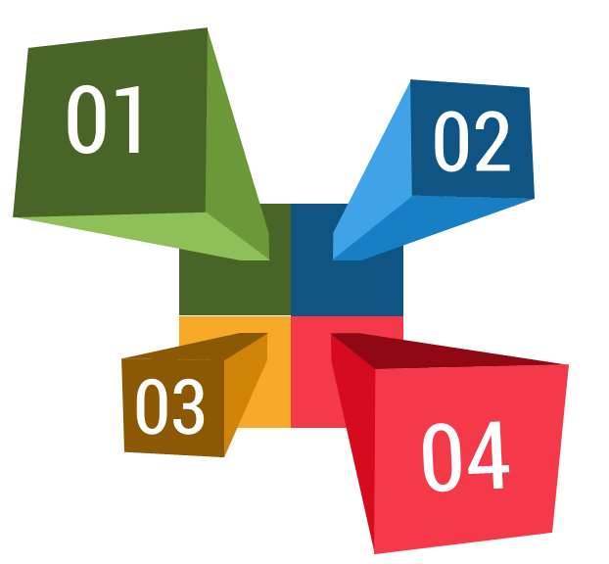
Summary
Trade & gender issues in the 2030 Agenda and the AAAA
Gender inequalities are pervasive in society and in the economy
The two sides of the trade & gender nexus: from gender inequality to trade performance and from trade to gender equality
New initiatives by the trade community

Slide 35

Thank you for your attention
https://UNCTAD.org/gender
gender@un.org
https://twitter.com/unctadgender
Prosperity for all

