Slide 1


Entrepreneurship and SDGs
Lorenzo Tosini
UNCTAD
Division on Investment and Enterprise

Slide 2


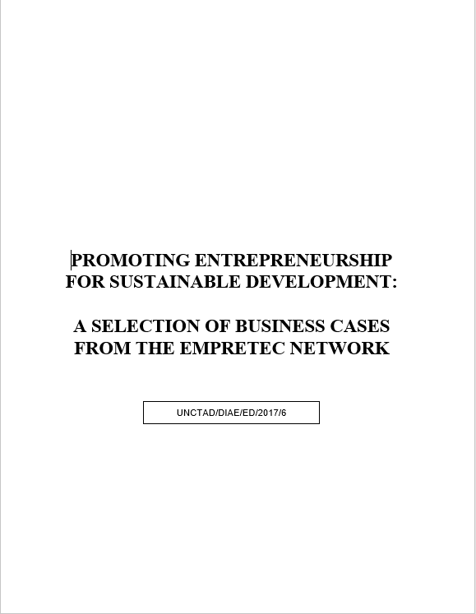
Promoting entrepreneurship for development

Slide 3
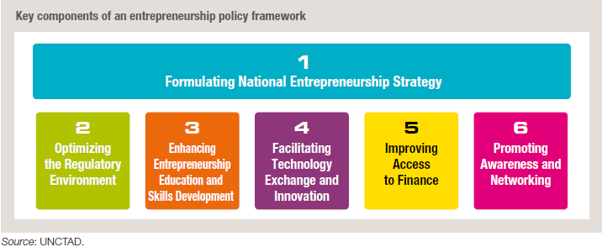
UNCTAD's Entrepreneurship Policy Framework (EPF)
Website: unctad.org/epf

Slide 4
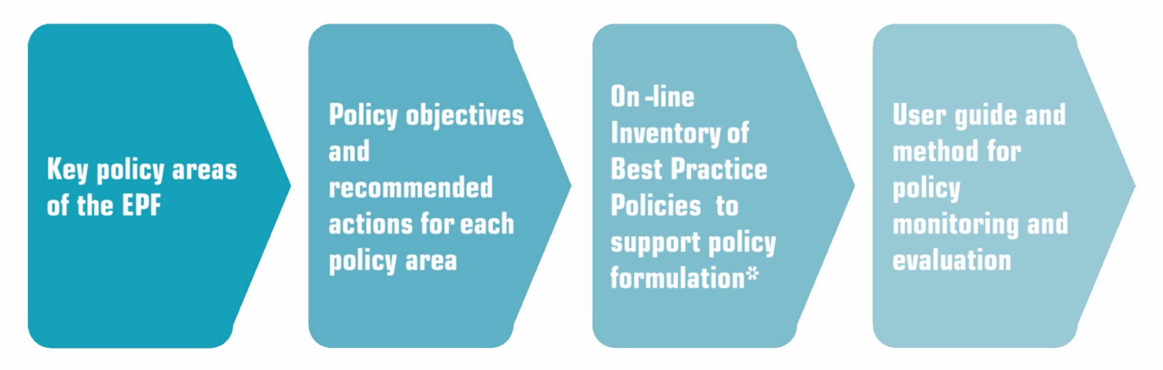
The EPF as a toolkit
For each policy area:
Policy objectives and recommended actions
Checklist of questions
Set of indicators to measure overall policy effectiveness
On-line inventory of good practices
The EPF provides a practical toolkit for the formulation, implementation and monitoring of entrepreneurship policies

Slide 5
Assessing the situation in your country
1. Formulating National Entrepreneurship Strategy | If yes: Overall, how would you rate the existing measures in this area? |  |  | 1: Weak 2: Moderate 3: Adequate 4: Strong
a. Identify country specific challenges and opportunities, specify goals and set priorities | NO | YES |  | 1 | 2 | 3 | 4
Q1: Are there regular surveys for assessing the national entrepreneurial environment? |  |  | If yes:
Q2: Does the government take into account relevant entrepreneurial environment indicators (e.g. Global Entrepreneur Monitor [GEM] Report, etc.) in policy decision making? |  |  | If yes:
Q3: Is there clarity about the types of entrepreneurship that the country wants to encourage? |  |  | If yes:
Q4: Are there any deliberate policies seeking to promote formal entrepreneurial activity among specific groups of the population? |  |  | If yes:
b. Ensure coherence of entrepreneurship strategy with other national policies | NO | YES |  | 1 | 2 | 3 | 4
Q5: Is entrepreneurship policy aligned with the country's overall development strategy? |  |  | If yes:
Q6: Is entrepreneurship embedded into other national policies (e.g. trade, investment, education, etc.)? |  |  | If yes:

Slide 6
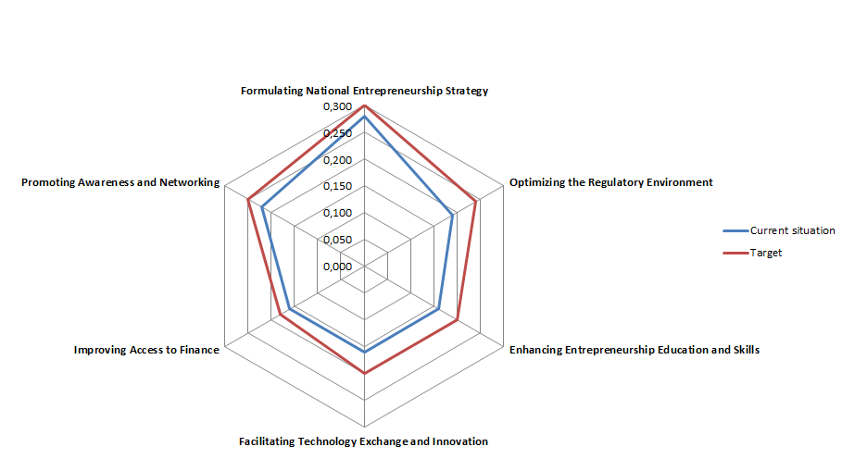
Indicators to measure policy effectiveness
 | 1 | 2 | 3 | 4 | 5 | 6
 | Formulating National Entrepreneurship Strategy | Optimizing the Regulatory Environment | Enhancing Entrepreneurship Education and Skills | Facilitating Technology Exchange and Innovation | Improving Access to Finance | Promoting Awareness and Networking
Current situation | 0.280 | 0.190 | 0.160 | 0.160 | 0.160 | 0.220
Target | 0.3 | 0.24 | 0.2 | 0.2 | 0.18 | 0.25

Slide 7
Steps to develop a national entrepreneurship strategy
Entrepreneurial Ecosystem Assessment
Goals:
Developing a strong institutional framework
Identify how entrepreneurship will contribute to national goals such as job creation, innovation and/or economic growth
Engaging all key public and private institutions
Identify target sub-groups within entrepreneurs (associations, networks, etc.)
National Consultation
National Plan for Entrepreneurship
Design Framework to Implement Entrepreneurship
Monitoring and Evaluation

Slide 8
Social, economic and environmental challenges
The role of entrepreneurship in addressing these challenges
Social entrepreneurship to alleviate poverty while engendering inclusive growth
Youth entrepreneurship to address global youth unemployment
Women entrepreneurship to promote gender equality and enhance women’s economic empowerment
Green entrepreneurship to support environmental sustainability, using efficient products, processes and practices

Slide 9
Selected policy measures on entrepreneurship for SDGs (1/2)
Integrate SDGs into national entrepreneurship strategies
Build enabling regulatory frameworks for green and social entrepreneurs
Promote women’s economic empowerment and equal rights
Implement targeted public procurement measures for disadvantaged groups
Integrate green and social entrepreneurship into educational systems and curricula

Slide 10
Selected policy measures on entrepreneurship for SDGs (2/2)
Encourage innovative financing arrangements for social and green entrepreneurs
Encourage crowd-funding, peer-to-peer lending and digital financing for women and youth entrepreneurs
Establish accelerators and incubators that provide specialized business support to social and green entrepreneurs
Promote inclusive entrepreneurship networks, among and for women and youth
Promote entrepreneurship mentoring, with a focus on women and youth

Slide 11

Integrate SDGs into national entrepreneurship strategies
Ethiopia’s Growth and Transformational Plan
Ethiopia’s Growth and Transformational Plan (2016-2020) identifies the micro and small and medium-sized enterprises (MSME) sector as a critical element in increasing women’s income through job creation and addresses economic empowerment of women and youth.
At the same time, the National Action Plan for Gender aims to eliminate gender and cultural biases that hinder women from engaging in economic activities.

Slide 12
Enabling regulatory frameworks for green and social entrepreneurs
Viet Nam’s Enterprise Law
In 2014, Viet Nam amended its Enterprise law to recognize social enterprises. These entities have preferential treatment in receiving licenses and certificates and can obtain funding, sponsorship and investment from Viet Nam as well as from international supporters.

Slide 13

Promote women’s economic empowerment and equal rights
According to Women’s Entrepreneurial Venture Scope (WE Venture Scope), Chile has the most conducive business climate for women entrepreneurs in Latin America and the Caribbean.
Its low corporate taxes, highly supportive business climate, a simplified tax regime that facilitates startups, and adequate provision of social services for female entrepreneurs, makes it an ideal environment for women entrepreneurs.

Slide 14

Implement targeted public procurement measures for disadvantaged groups
As part of its Broad-Based Black Economic Empowerment (B-BEE) strategy, South Africa has implemented policies aimed at integrating previously disadvantaged communities (PDCs) into the mainstream economy, including black, women as well as persons with disabilities.
As part of the strategy and the Preferential Procurement Act, South Africa provides preferential allocation of contracts to PDCs.

Slide 15
Integrate green and social entrepreneurship into educational systems and curricula
Thailand’s newly drafted Social Enterprise Promotion Act has a provision on providing opportunities for capacity building for social enterprises and the integration of social entrepreneurship in the education system.
Encourage innovative financing arrangements for social and green entrepreneurs
Venture Capital Trust Fund (VCTF) has leveraged funding to provide low-cost financing to businesses, including SMEs as well as social enterprises that address pressing social issues such as unemployment, access to health and education. In 2011, VCTF established the Ghana Angel Investment Network (GAIN) which invests in early-stage growth-oriented enterprises.

Slide 16

Encourage crowd-funding, peer-to-peer lending and digital financing for women and youth entrepreneurs
Tanzania’s mobile savings account
M-Pawa is a mobile savings account that allows users to save money through their mobile phone, earn interest from their savings and eventually obtain a microloan when needed.
Establish accelerators and incubators that provide specialized business support to social and green entrepreneurs
Egypt’s green innovation hub
Icecairo is a green innovation hub that equips young people with green skills and business support to enable them to pursue green entrepreneurship and develop low-cost solutions that will address Egypt’s environmental challenges.

Slide 17

Promote inclusive entrepreneurship networks, among and for women and youth
Bangladesh Women’s Chamber of Commerce and Industry (BWCCI) is the first chamber of commerce in the country that works exclusively on women’s economic and social empowerment. Established in 2001, the organization encourages and strengthens women entrepreneurs’ participation in the private sector through promoting a women-friendly business environment.
Promote entrepreneurship mentoring, with a focus on women and youth
Brazil’s youth-led organization Engajamundo fosters interactions between Brazilian youth and international conferences related to the environment, social development and gender. It promotes the engagement of youth in negotiations and solutions for sustainability.

Slide 18



Thank you
 | lorenzo.tosini@unctad.org
 | +41 22 917 2431
 | lorenzo.tosini

