Slide 1
11:15 – 12:30 Trade facilitation: basic concepts, evolving content and most recent developments: challenges and opportunities for developing countries

Slide 2
Outline
Evolving concepts on Trade Facilitation
International Instruments related to Trade Facilitation
New Tools available
Trade facilitation reform
How to start

Slide 3
UNCTAD and Trade Facilitation
40 years of experience in the field
Promoting trade and transport facilitation Committees
Simplifying procedures and documents
Spreading standards in developing countries
Designing regional solutions
Designing automated systems for Customs
Organizing World Ministerial Columbus Ohio in 1994
Supporting Trade Facilitation in WTO in 1996
Supporting Developing countries participation in Doha Round
Designing solutions to support WTO TF Negotiations

Slide 4
Evolving concepts

Slide 5
Traditional definition
Simplification and harmonization of international trade procedures and documentation
Core elements:
Documents as support of information
Procedures as information processing
Main outcomes:
Standard documents
Standard data and codes
Standard protocols

Slide 6
Recent evolution
Transport corridors and trade channels
Supply chain management model
Core elements:
Goods movements rather than paperwork
Operational issues not only controls
Main outcomes:
Integrated approach on processes
Single international transaction

Slide 7
Potentially Misleading Beliefs
TF is just a matter of bureaucracy
TF is inexpensive & easy to implement

Slide 8
Data Flow for International Trade
Purchasing
Export
Import
Up to 20 Involved Parties
200+ data elements
Manual data exchange processes
Multiple data platforms
30+ documents or messages
60-70% repetitions
6-15% of the final value of the goods
40% of the transaction time
Bill of lading, Documentation
Vessel Booking Request
Confirmed Line of Credit
Vessel Booking Confirmation
Release/Approval
Importer’s Bank
Exporter’s Bank
Bill of Lading
Fund Transfer
Original B/L, Invoice, PO, Packing List
Rated Bill of Lading
Arrival Notice
Import Terminal Operator
Dock Receipt
Ocean Carrier
Line of Credit Proforma Invoice
Demurrage guarantee & payment
LC Confirmation
Export Terminal Operator
Cargo
Status
Purchase Order
Customs House Broker
Importer
Exporter
Dock receipt
Pick-up & Delivery Order
Proforma Invoice
Import Docs
Letter of Instruction Invoice, PO
Pick-up & Delivery Order
Release/Hold Notice
Cargo Status
Inland Carrier
Freight Forwarder / NVOCC
Inland Carrier
Shipping & Funding Detail
Dock receipt
Manifest
Customs ( Import )
Marine Insurance Company
Shipping & funding detail
Export Declaration
Vessel Manifest
AES
Export Declaration
Port
Converted Vessel
Manifest
Customs (Export)
Importer Notice

Slide 9
Available Trade Facilitation tools

Slide 10
Trade Facilitation Platforms
National and Regional Trade and Transport Facilitation Committees: as structures for dialogue with private stakeholders, inter-agency coordination and high level policy coherence at national level in the design of administrative reforms.
WTO Trade Facilitation Support Groups: as coordinating mechanisms to support national negotiators in Geneva through the provision of technical expertise and feedback on the tabled proposals.
Transit corridor facilitation clusters: as operational multi stakeholders multi national cooperative platforms to assess obstacles, design and implement solutions to improve transport corridor operations and management.

Slide 11
Repository of Trade Facilitation Working Groups
A joint initiative by UNCTAD and UNECE the repository of national working group on trade facilitation, provides a collection of country's experiences in setting up and maintaining national inter-agency public private consultative trade facilitation mechanisms
The country experiences currently include Benin, Burkina Faso, Ecuador, Mali, and St. Lucia. It is planned to expand the number of countries’ participating during this and the following year.
See:http://r0.unctad.org/ttl/repository/TFWGintro.htm.

Slide 12
Clusters along Transport Corridors
Customs
Carrier
Freight Forwarder
Shipper
Cluster

Slide 13
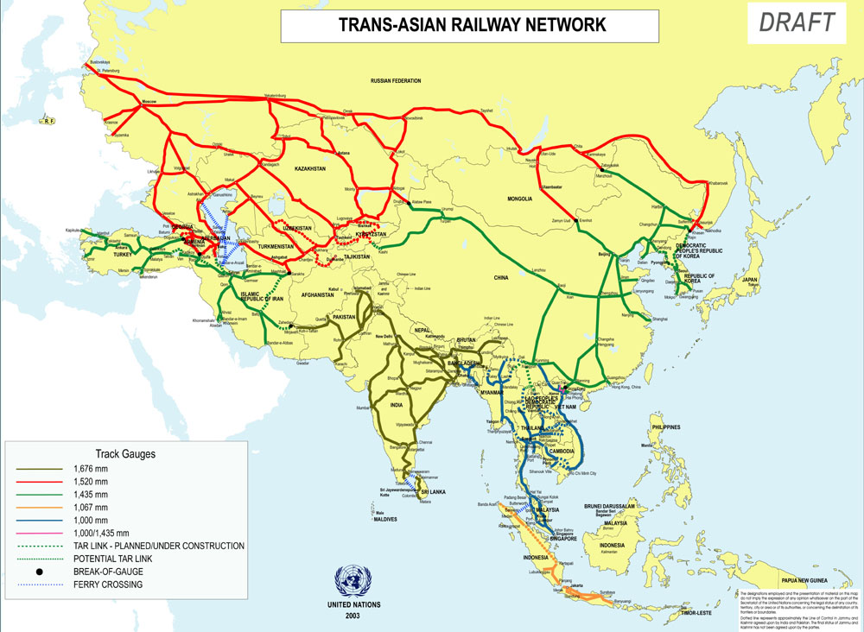
Time/Cost – Distance Methodology
Ulaanbaatar
Tianjin Port

Slide 14
Example: Tianjin-Ulaanbaatar Railway link
Day 4
Ulaanbaatar
1700 km
75 hrs 31 min.
04.18 a.m.
Day 3
Average speed
27.5 km/h
22.4 km/h
02.30 a.m.
Zamyn Uud
Day 2
1000 km
20 hrs 31 min.
29 hrs 12 min.
05.59 a.m.
Day 1
Tianjin, 0 km
Erenhot, 983 km
1,691 km
33.7 km/h
Time
500 km
1000 km
1500 km
2000 km
Distance
Transshipment:
3 hrs. 20 min.
Customs:
China,
3 hrs. 00 min.
(3.5 min. per box)
Mongolia,
4 hrs. 50 min.
Shunting + train formation:
3 hrs. 35 min.

Slide 15
Border Crossings: Cost or Time
Cost per TEU
$700
$650
$600
$500
$400
$300
$293
$131
$155
$124
$200
$200
$100
$100
$0
Lao PDR-
Thai
Lao PDR-
Viet Nam
Mongolia-
China
Mongolia-
Russian Fed.
Nepal-
India
Kazakhstan-
Russian Fed.
*Uzbekistan-
Turkmenistan
* Estimated from cost of standard European 12 meter semi trailer.

Slide 16
UNCTAD Liner Shipping Connectivity in 2009
Source:http://www.unctad.org/transportnews
Notes:
Generated in its sixth year, UNCTAD’s Liner Shipping Connectivity Index (LSCI) aims at capturing how well countries are connected to global shipping networks.
As regards global developments of the individual LSCI components, the 2009 data also reflects the impacts of the economic crisis. Between July 2008 and July 2009, the number of ships, their total TEU carrying capacity, the number of services and the number of companies have all decreased. Only the maximum vessel size has continued to increase as new and larger vessels are being delivered by the world’s ship yards. Many of these larger ships then replace smaller vessels, leading to a significant reduction in the average number of vessels per country.
For the first time since UNCTAD records the data, the average container carrying capacity TEU assigned per country has fallen. Following the continued trend of mergers and acquisitions, the average number of companies offering services per country has decreased by 17 per cent since 2004 (figure 1).

Slide 17
Transit Countries LSCI 2004-2009

Slide 18
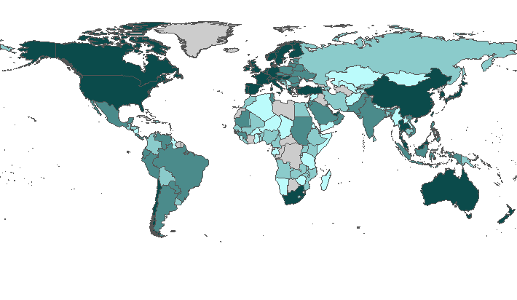
WB - Logistics Performance Index
 | 1 <= LPI <= 2.29 |  | 2.29 <= LPI <= 2.53
 | 2.53 <= LPI <= 3.14 |  | 3.14 <= LPI <= 5
 | No data | 1 is the lowest score and 5 is the maximum score.
Source:www.worldbank.org/lpi

Slide 19
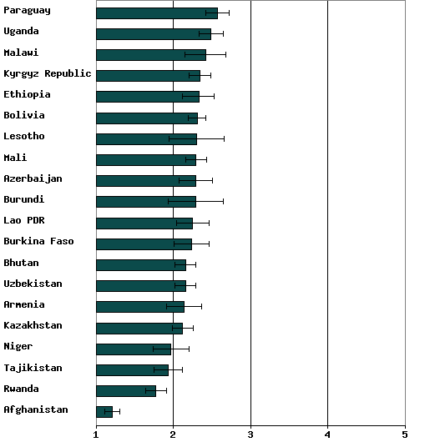
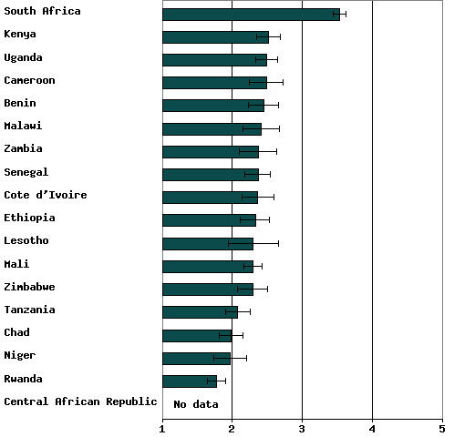
LPI 2009 – LLDCs and transit

Slide 20
Trade facilitation reform

Slide 21
Reform Policy Objectives
External commitments:
Bilateral and regional agreements
WTO
Internal objectives:
Administrative effectiveness
Better trade management
Better use of public resources
Trade competitiveness
Support national trade sector
Lower transaction costs

Slide 22
Common Reform Phases
Definition of goals to achieve the objectives
Analysis of the capacity of the current processes to achieve the goal
Analysis of required actions to fill the gaps
Assessment of needs/resources for identified actions
Design of individual processes
Development of comprehensive plan
Implementation of the solution
Operation and maintenance of the new system

Slide 23
Elements in each phase
Staffing: manpower / technical skills
Technology: equipment and training
Institutional: functions, interactions and management
Regulatory: authority and mandates
Budgeting costs / revenues
All the above for three different levels:
Planning and monitoring unit : goals – analysis – solution - sequencing
Design and development units: analysis and process development
Implementation units: operation and maintenance of the system

Slide 24
Sequences to introduce reform
Function sequence depends on:
Steps to take before
Impact on consecutive processes
Priority sequence depends on:
External commitments
Other defined objectives
Time sequence depends on:
Priorities
Resource deployment

Slide 25
Three dimensions
TRADE
TRANSPORT
Trade
Facilitation
CUSTOMS

Slide 26
CUSTOMS dimension
Customs Reform
and Modernization
faster clearance
of cargo
Customs Facilitation
Simplify/harmonize
documents & procedures
Increased Customs
revenues
Implement modern
Customs laws
Support automated
data systems
ASYCUDA

Slide 27
TRADE dimension
Best-recommended
commercial practices
Trade Facilitation
faster RoI
for IMP
Simplify IMP/EXP
documents & procedures
Transit Agr.
Competitive
exports
Create awareness on
best practices
Promote
Single Window

Slide 28
TRANSPORT dimension
Best-recommended
transport practices
Faster turn-over
of means
Transport Facilitation
Create awareness on
modern transport & logistics
smooth movement
of goods
Establish norms
(incl. liability insurance)
Implement modern
Transport laws
Implement logistics tools

Slide 29
International Instruments related to Trade Facilitation

Slide 30
Instruments outside WTO
ICC International Customs Guidelines;
ICS rec. on B/L and ship’s manifest;
IMO FAL Convention;
IMO: other conventions with TF relevance (7);
Relevant ISO Standards;
UN/ECE (& UN/CEFACT) Recommendations;
UN/ECE TIR Convention;
UN/ECE CMR Convention;
WCO: Revised Kyoto Convention;
WCO: Istanbul Conv. (Temporary Admission);
WCO: Nairobi Conv. on Prevention, Investigation & Repression of Customs offences;
WCO: Various other WCO Customs Conv. (9);
WCO: Various non-binding WCO rec. (5);
Free trade agreements and/or Customs unions.

Slide 31
Existing WTO rules on trade facilitation
Agreement on the Implementation of Article VII GATT 1994 (Customs Valuation)
Agreement on Preshipment Inspection
Agreement on Import Licensing Procedures
Agreement on Rules of Origin
Agreement on Technical Barriers to Trade
Agreement on Sanitary and Phytosanitary Measures

Slide 32
Trade facilitation in Regional Trade Agreements

Slide 33
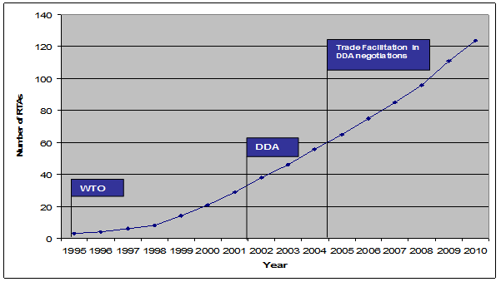
Trade Facilitation in Regional Trade Agreements
The number of provisions related to customs and trade facilitation included in Regional Trade Agreements (RTAs ) has increased over time, reflecting the growing importance of trade facilitation at the regional level.
Increasing number of RTAs with customs and other trade facilitation measures (Source: UNCTAD Secretariat based on WTO RTA Database)

Slide 34
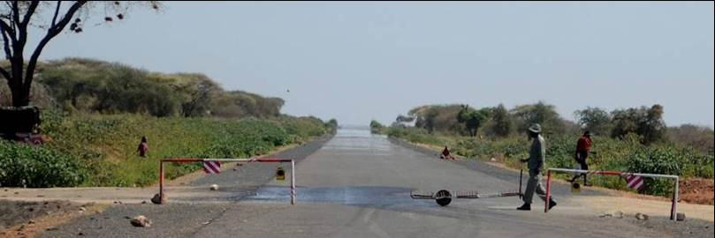
Trade facilitation and discrimination by RTAs
Does in regional agreements lead to discrimination against those outside the RTA?
Are regional commitments aligned with WTO commitments?
Could RTAs help the WTO Trade Facilitation Agreement?
Consistency with future WTO rules, can benefit all trading nations without discrimination
Use of international standards

Slide 35
118 RTAs reviewed
To determine:
the types of trade facilitation measures contained,
the relationship between these measures and the World Trade Organization (WTO) principle of most favoured nation (MFN),
the differences and overlaps among selected trade facilitation measures under different RTAs, and
the benefits and risks brought by being part of multiple RTAs, and actions to be taken to minimise potentially adverse effects.

Slide 36
Types of trade facilitation measures in RTAs
Source: UNCTAD Secretariat

Slide 37
Policy options available to countries
Cohesive approach to trade facilitation
Pending the adoption of a WTO agreement, RTAs can help in moving the trade facilitation agenda forward.
Customs and other trade facilitation measures adopted in RTAs have created trade facilitation implementation capacities in many countries and regions.
Most of the provisions existing in RTAs in fact go deeper and broader in terms of trade facilitation benefits than the current WTO provisions under the GATT Articles V, VIII and X.
Policymakers should ensure a coherent approach to the negotiation and implementation of bilateral, regional and multilateral trade facilitation commitments.

Slide 38
Trade facilitation in the pre-Singapore context

Slide 39
TF work before WTO – from early 60’s to 1994…
Work of the UNECE and UNCTAD
UNECE Recommendations (UNLK, UN/EDIFACT, LOCODE, etc)
UNCTAD FALPRO
UN International Symposium on Trade Efficiency (UNISTE) in Columbus, Ohio (1994):
Banking & Insurance;
Customs;
Business Information for Trade;
Transport;
Telecommunications.

Slide 40
Related existing body of WTO Law
Current provisions pertaining to areas of trade facilitation
Agreement on Customs Valuation
Agreement on Pre-shipment inspection
Agreement on Import Licensing
Agreement on SPS
and
GATT 1947 (1994)

Slide 41
Why multilateral rules?
1) Lack of effective implementation of the instruments
Non-binding feature of these instruments
(including the relevant GATT articles)
Lack of political will for implementation
Not only own reform efforts but trading partners‘ efforts are important
2) International Standards and rules

Slide 42
From early 70’s to 1996…
Work of the UNECE and UNCTAD
UNECE Recommendations
UNCTAD FALPRO
UN International Symposium on Trade Efficiency (UNISTE) in Columbus, Ohio (1994):
Banking & Insurance;
Customs;
Business Information for Trade;
Transport;
Telecommunications.

Slide 43
Existing non-compulsory international instruments and best practices
Internationally-accepted customs and practices, negotiated by interested Governments thru international organizations and private sector institutions;
Lack of effective implementation of the instruments;
Non-binding feature of these commitments.

Slide 44
GATT 1994
Article V Freedom of Transit
Article VIII Fees and Formalities connected with IMP/EXPortation
Article X Publication and Administration of Trade Procedures
Agreement on the Implementation of Article VII (Customs Valuation);
Agreement on Preshipment Inspection;
Agreement on Import Licensing Procedures;
Agreement on Rules of Origin;
Agreement on Technical Barriers to Trade;
Agreement on Sanitary and Phytosanitary Measures.

Slide 45
Trade facilitation in the post-Singapore context

Slide 46
History of TF in the WTO
Singapore Issues
1996
200x
1. WTO Ministerial Conference

Slide 47
« Trade And » Issues
Developed countries proposed new « topics » to be included in the WTO trade negotiations; so-called Singapore Issues were:
Investment and related regimes
Competition Policy
Policy related to Government procurement
Trade related procedures = Trade Facilitation

Slide 48
Mandate of WTO Work Programme
Singapore Ministerial Declaration (1996)
Article 21: “We further agree to:
direct the Council for Trade in Goods to undertake exploratory and analytical work, drawing on the work of other relevant international organizations, on the simplification of trade procedures in order to assess the scope for WTO rules in this area.”

Slide 49


History of TF in the WTO
Singapore Issues
1996
2001
1. WTO Ministerial Conference

Slide 50
Doha Declaration (2001)
27. Recognizing the case for further expediting the movement, release and clearance of goods including goods in transit and the need for enhanced technical assistance and capacity building in this area, we agree that negotiations will take place after the Fifth Session of the Ministerial Conference on the basis of a decision, by explicit consensus, at that Session on modalities of negotiations. In the period until the Fifth Session, the Council for Trade in Goods shall review and as appropriate, clarify and improve relevant aspects of Articles V, VIII and X of the GATT 1994 and identify the trade facilitation needs and priorities of Members, in particular developing and least-developed countries. We commit ourselves to ensuring adequate technical assistance and support for capacity building in this area.
(WT/MIN(01)/DEC/W/1, 14 November 2001)

Slide 51

Timeline of TF at WTO
Singapore Issues
1996
2001
2003
200x
1. WTO Ministerial Conference

Slide 52
Work programme 2002-2003 from Doha to Cancun
Meetings in the framework of regular CTG sessions;
Core agenda:
GATT Articles V, VIII and X
Trade facilitation needs and priorities of Members
Technical assistance and capacity building
Numerous proposals, national experiences on the Articles;
Low focus on N&P, TA and CB.
Cancun is not a success but Trade Facilitation stays “on-board”.

Slide 53

Singapore Issues vs. Cancun
At the Ministerial Conference 2003 in Cancun a coalition of developing countries refused to open negotiations on new topics
Trade Facilitation
Government Procurement (§26 DD)
Investment (§20-22 DD)
Competition (§23-25 DD)

Slide 54

Timeline of TF at WTO
Singapore Issues
July Package
1996
2001
2003
2004
200x
1. WTO Ministerial Conference
Notes:
Work programme 2002-2003 from Doha to Cancun
Meetings in the framework of regular CTG sessions;
Core agenda:
GATT Articles V, VIII and X
Trade facilitation needs and priorities of Members
Technical assistance and capacity building
Numerous proposals, national experiences on the Articles;
Low focus on N&P, TA and CB.
Cancun is not a success but Trade Facilitation stays “on-board”.

Slide 55
The WTO July 2004 Package

Slide 56
The Negotiating Mandate
On 1 August 2004, the General Council decided to commence negotiations on TF on the basis of the modalities set out in Annex D. (WT/L/579)
Objective of negotiations (para 1):
Clarify and improve relevant aspects of GATT Articles V, VIII and X.
Enhance technical assistance and support for capacity building.
Provide effective cooperation between customs or other appropriate authorities on TF and customs compliance

Slide 57
Annex D - Modalities
S&D treatment (para. 2):
SDT should extend beyond traditional transition periods for implementing commitments.
Extent and timing of commitments shall be related to implementation capacities of developing countries and LDCs.
Developing countries and LDCs are not obliged to undertake investments in infrastructure beyond their means.
Additional S&D treatment for LDCs (para. 3):
LDcs will only be required to undertake commitments to the extent consistent with their individual development, financial and trade needs; or their institutional capabilities.

Slide 58
Annex D - Modalities
Work on areas of particular interest to developing countries and LDCs (para. 4):
Identification of TF needs and priorities;
Address concerns of developing and LDCs related to cost implications of proposed measures.

Slide 59
Annex D - Modalities
TA & CB during the negotiations (para. 5):
Recognized vital for developing and LDCs to fully participate and benefit from negotiations.
Developed countries commit to adequately ensure such support and assistance during negotiations.
TA & CB after the negotiations (para. 6):
Assistance to help implement commitments in accordance with their nature and scope;
Support for infrastructure development in certain cases;
Linkage between provision of assistance and implementation requirement.

Slide 60
Annex D - Modalities
Technical assistance and support for capacity building (para. 7, 8 & 9):
Review of effectiveness of assistance provided and its ability to support implementation of results of negotiations;
Collaborative effort among international organisations to enhance effectiveness of assistance and ensure better coherence.

Slide 61
Other elements of the mandate
The negotiations on TF and their outcome are part of the “Single undertaking”.
The TNC was instructed to establish a Negotiating Group on TF (NGTF) and to appoint its chair (Amb. Noor, Malaysia, now Amb. Eduardo Spirensen Guatemala).
The NGTF held 15 meetings up to mid-2006;
More than 100 proposals from Members;
Report to the Trade Negotiations Committee (TN/TF/3)
The report was endorsed as Annex E of the Declaration of the Hong Kong Ministerial Conference (Dec.05).

Slide 62
Where do we stand now ?

Slide 63
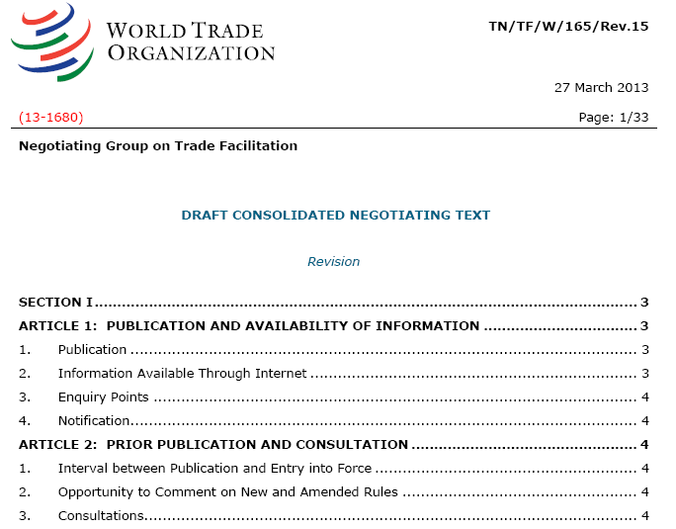
Consolidated Negotiating Text

Slide 64
ARTICLE 1: PUBLICATION AND AVAILABILITY OF INFORMATION
ARTICLE 2: PRIOR PUBLICATION AND CONSULTATION
ARTICLE 3: ADVANCE RULINGS
ARTICLE 4: APPEAL PROCEDURES
ARTICLE 5: OTHER MEASURES TO ENHANCE IMPARTIALITY, NON-DISCRIMINATION AND TRANSPARENCY
ARTICLE 6: FEES AND CHARGES CONNECTED WITH IMPORTATION AND EXPORTATION
ARTICLE 7: RELEASE AND CLEARANCE OF GOODS
ARTICLE 8: CONSULARIZATION
ARTICLE 9: BORDER AGENCY COOPERATION
ARTICLE 9 BIS: DECLARATION OF TRANSHIPPED GOODS
ARTICLE 10: FORMALITIES CONNECTED WITH IMPORTATION AND EXPORTATION
ARTICLE 11: FREEDOM OF TRANSIT
ARTICLE 12: [CUSTOMS] COOPERATION [MECHANISM FOR [TRADE FACILITATION AND] [[CUSTOMS][TRADE]] COMPLIANCE]
ARTICLE 13: INSTITUTIONAL ARRANGEMENTS
ARTICLE 14: NATIONAL COMMITTEE ON TRADE FACILITATION
ARTICLE 15: PREAMBLE/CROSS-CUTTING MATTERS
TRANSITIONAL / SPECIAL AND DIFFERENTIAL TREATMENT PROVISIONS FOR DEVELOPING COUNTRY MEMBERS AND LEAST DEVELOPED COUNTRY MEMBERS

Slide 65
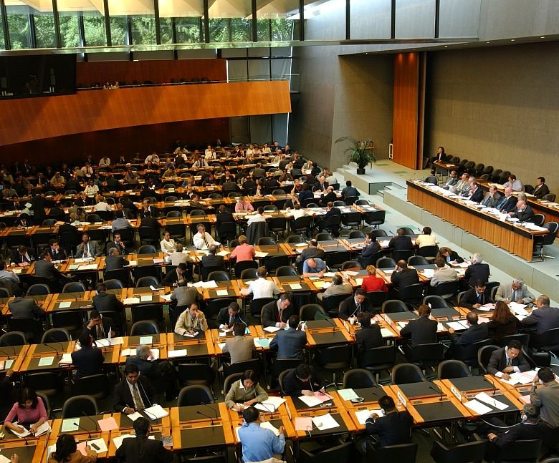

Slide 66


Slide 67
Thank you
UNITED NATIONS CONFERENCE ON TRADE AND DEVELOPMENT
José María Rubiato
UNCTAD – Trade Logistics Branch
jose.rubiato@unctad.org

