Slide 1
Harnessing FDI for Sustainable Development:
UNCTAD’s IPFSD
Investment Policy Framework for Sustainable Development
International Investment Policymaking dimension
Natalia Guerra de Arias
Senior Capacity-building Coordinator
International Investment Agreements (IIAs)
Division on Investment and Enterprise
UNCTAD

Slide 2
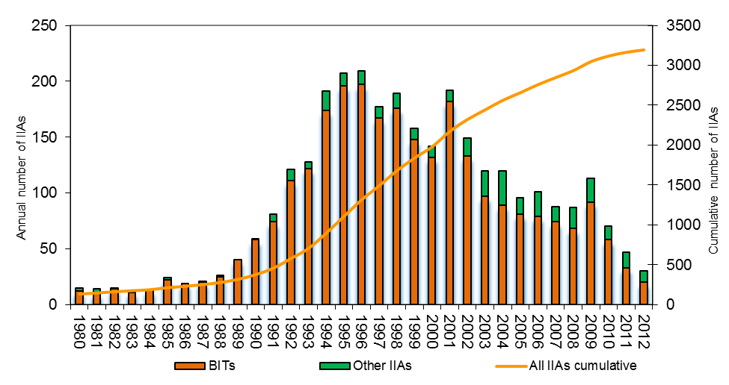
International Investment Policies:
Shifting from the bilateral to the regional level
Trends of BITs and “other IIAs”, 1980 – 2012
(Number of treaties)
Notes:
2

Slide 3
ISDS Mechanism:
Investors continue using it – some States express discontent

Slide 4
IPFSD: Core Principles for Investment Policymaking
1
Investment for sustainable development
…overarching objective of investment policymaking …
2
Policy coherence
…grounded in a country’s overall development strategy
… coherent and synergetic …
3
Public governance and institutions
…involving all stakeholders … standards of public governance
…predictable, efficient and transparent procedures for investors
4
Dynamic policymaking
…regular reviews for effectiveness and relevance …
5
Balanced rights and obligations
…setting out rights and obligations of States and investors in the interest of development
6
Right to regulate
…in the interest of the public good and to minimize potential negative effects
7
Openness to investment
…in line with development strategy
… open, stable and predictable entry conditions …
8
Investment protection and treatment
…adequate protection to established investors … non-discriminatory
9
Investment promotion and facilitation
…aligned with sustainable development goals
… minimize risk of harmful competition for investment
10
Corporate governance and responsibility
…promote adoption of and compliance with best international practices of CSR …
11
International cooperation
…address shared investment-for-development challenges
… avoid investment protectionism

Slide 5
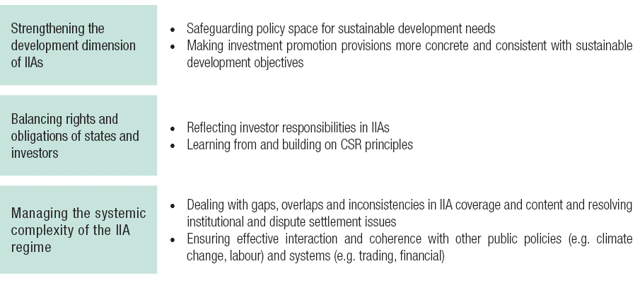
International Investment Policymaking: the Challenges

Slide 6
International Investment Policymaking: 3 Levels
Formulating a strategic approach to international engagement on investment
  Integrating IIAs into a country's development strategy
  Understanding what IIAs can and cannot do
Designing sustainable development friendly IIA clauses
  What type of agreement (BIT or FTA)
  What type of relationship (bilateral or regional)
  With whom
Engaging in multilateral consensus building

Slide 7
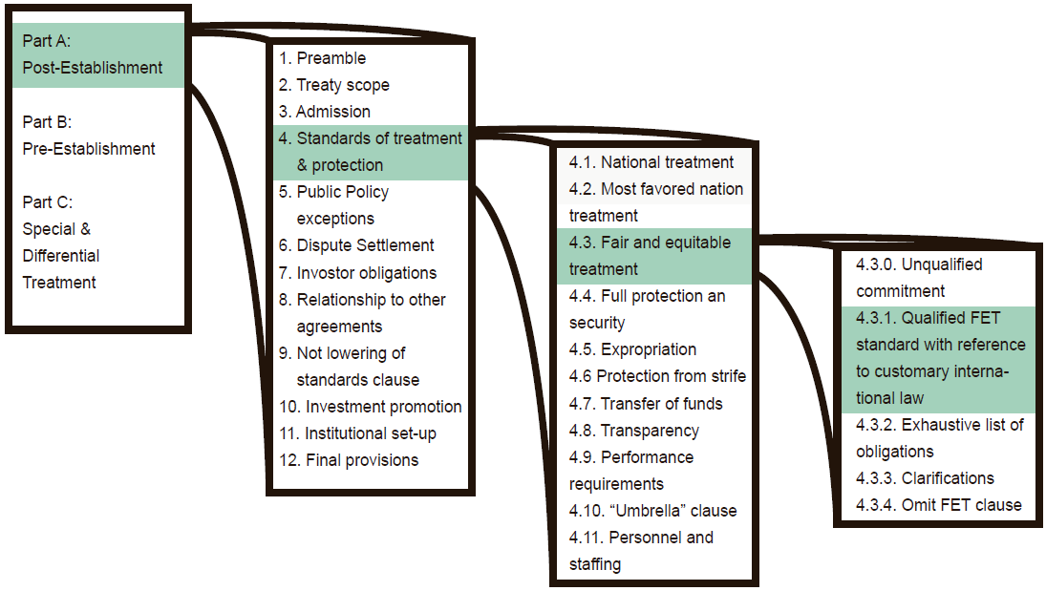
IIA Table of Elements in the IPFSD: How It Works

Slide 8
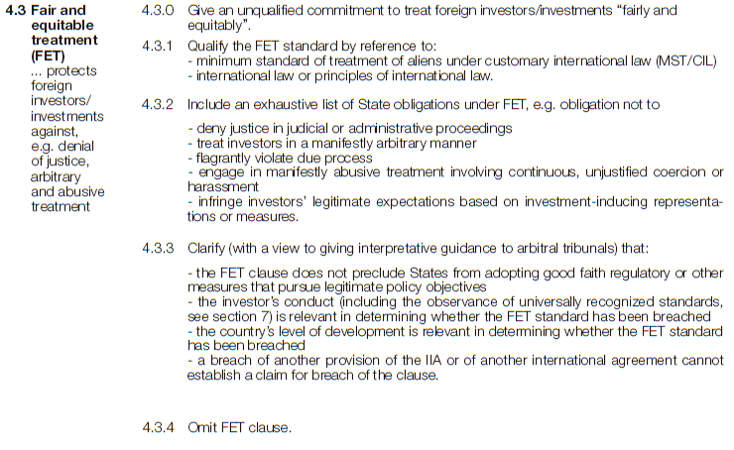
An Excerpt from the IPFSD Framework
Notes:
8

Slide 9
IPFSD Policy Options – Some Examples
Carefully craft scope and definitions clause.
Structure FET as an exhaustive list of State obligations.
Distinguish legitimate regulations from regulatory takings.
Make full protection and security commensurate with a country’s level of development.
Limit the scope of the transfer of funds clause.
Include exceptions to protect human rights, health, labor standards, and the environment.
Consider no ISDS, or last resort ISDS jurisdiction.
Create an institutional setup that makes the IIA adaptable to changing development contexts.
Notes:
9

Slide 10
Selected aspects of IIAs signed in 2012 | Policy Objectives
IPFSD Policy Options – Some Examples | Sustainable development enhancing features | Focus on investments conducive to development | Preserve the right to regulate in the public interest | Avoid over-exposure to litigation | Stimulate responsible business practices
in order of appearance
References to the protection of health and safety, labour rights, environment or sustainable development in the treaty preamble | X | X | X |  | X
Exclusion of portfolio investment (shares representing less that 10 per cent of a company’s capital) from the range of assets protected by the treaty |  | X
Exclusion of sovereign debt obligations from the range of assets protected by the treaty |  |  |  | X
A carve-out for prudential measures in the financial services sector |  |  | X | X
Fair and equitable standard equated to the minimum standard of treatment of aliens under customary international law |  |  | X | X
Clarification of what does and does not constitute an indirect expropriation |  |  | X | X
Detailed exceptions from the free-transfer-of-funds obligation, including balance-of-payments difficulties and/or enforcement of national laws |  |  | X | X
Omission of the so-called “umbrella” clause |  |  |  | X
General exceptions, e.g. for the protection of human, animal or plant life or health; or the conservation of exhaustible natural resources | X |  | X | X
Explicit recognition that parties should not relax health, safety or environmental standards to attract investment | X | X |  |  | X
Promotion of Corporate and Social Responsibility standards by incorporating a separate provision into the IIA or as a general reference in the treaty preamble | X
Limiting access to ISDS (e.g. limiting treaty provisions subject to ISDS, excluding policy areas from ISDS, granting consent to arbitration on a case-by-case basis, limiting the time period to submit claims) |  |  | X | X

Slide 11
IPFSD: What for? End-use
Reference for policy making: a "policy at a glance" for politicians, a handbook for national policy makers, and “checklist of options” for treaty negotiators
Tool for technical assistance: framework for IPRs, basis for updating regulatory regimes, menu for training, a handbook for general advisory services
Basis for consensus-building:
  Short-term: promoting common understanding on key issues related to investment for sustainable development;
  Longer-term: a stepping stone for formulating common denominators of multilateral cooperation
Living framework for all stakeholders to contribute: "open source“ on the web and discussion forum for best practices.

Slide 12
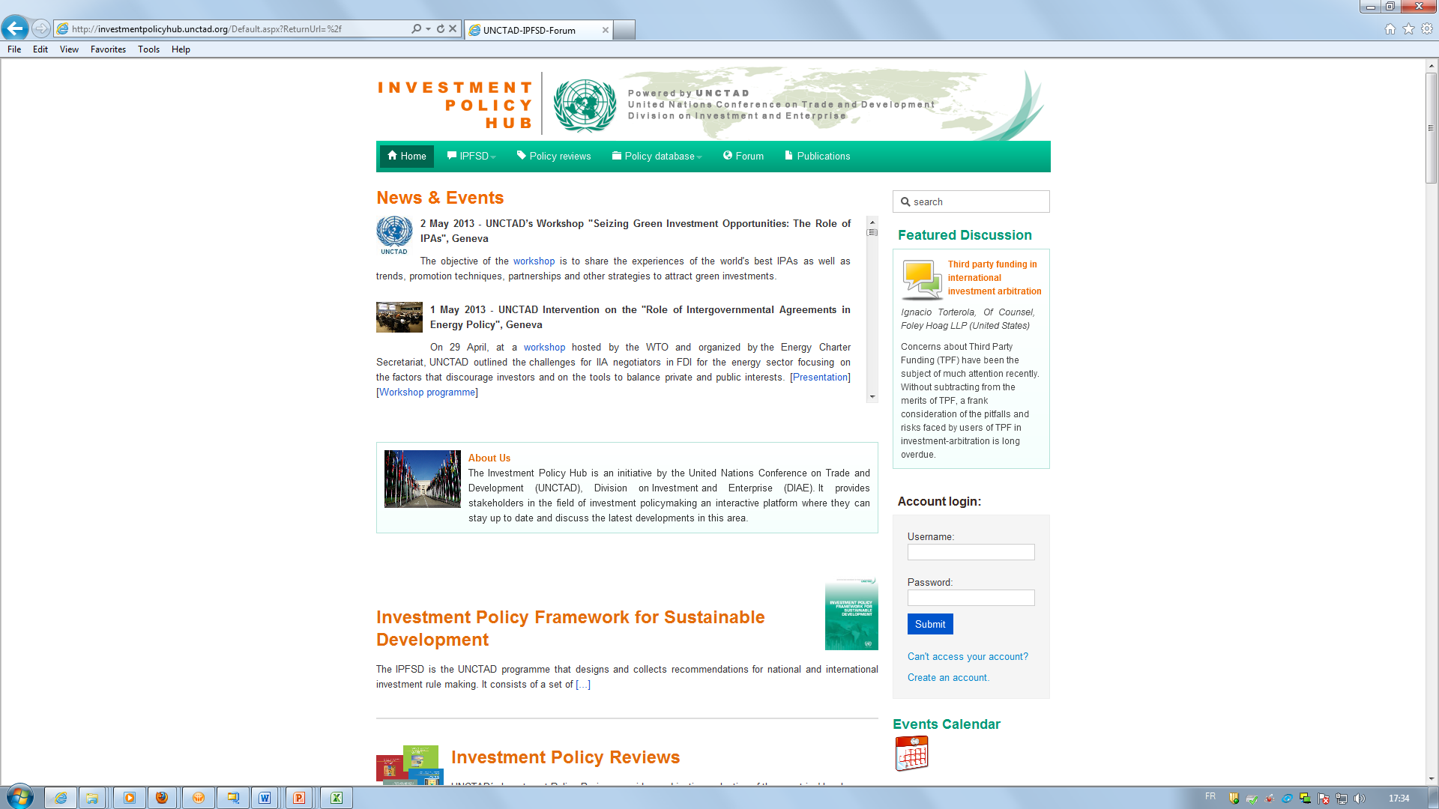
The Investment Policy Hub and the IPFSD

Slide 13

THANK YOU!
The Investment Policy Hub:
http://investmentpolicyhub.org
UNCTAD websites:
www.unctad.org/diae
www.unctad.org/wir
www.unctad.org/fdistatistics
@unctadwif

