Slide 1
Manufacturing Success:
Structural transformation, industrial policy and the rise of the South
Geneva, 15 April 2011
Richard Kozul-Wright
Notes:
1

Slide 2
Structural transformation
Economic development requires structural transformation – new activities + shifting resources:
Source of productivity growth (Lewis)
Virtuous supply and demand side linkages (Kaldor)
Learning economies (Schumpeter)
Is industry special? Yes and no
Structural transformation more important to developing than developed countries – large productivity gaps between different parts of their economy

Slide 3
Economic growth and structural change, 1970-2003

Slide 4
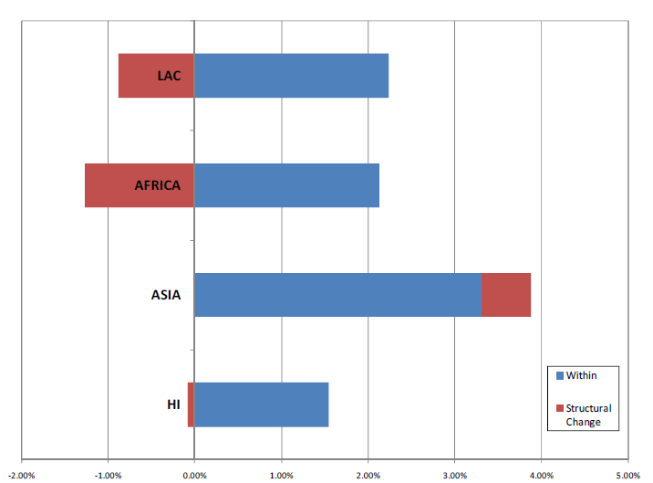
Globalisation and structural change: Winners and losers, 1990-2005

Slide 5
What you (produce and) export matters
Why countries trade:
Comparative advantage (static)
Technology/learning (dynamic)
Vent for surplus
Balance of payments
Sophistication (diversification) some traded goods are associated with higher productivity levels than others and countries that latch on to higher productivity goods perform better.

Slide 6
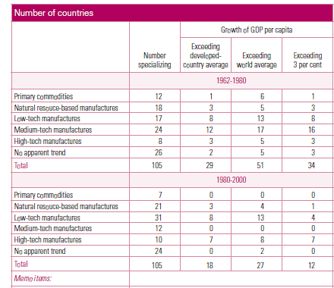
What you trade has an impact on growth

Slide 7
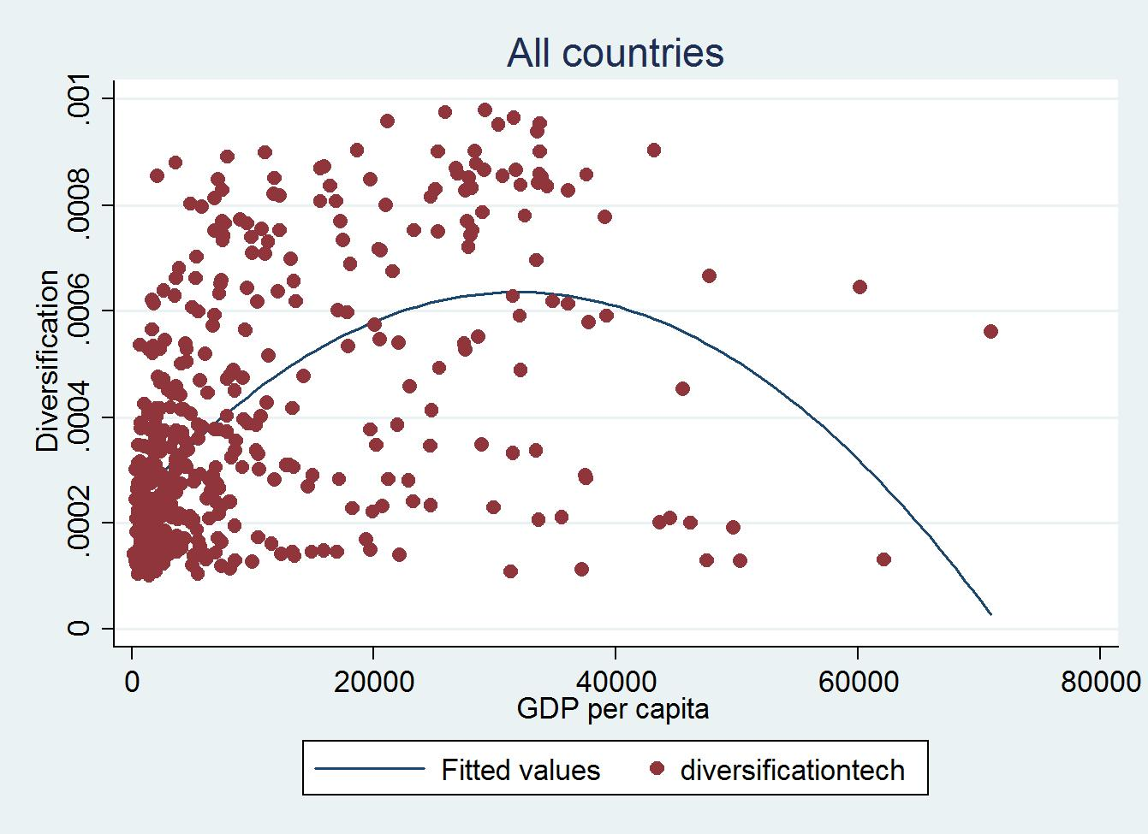
Export diversification and growth

Slide 8
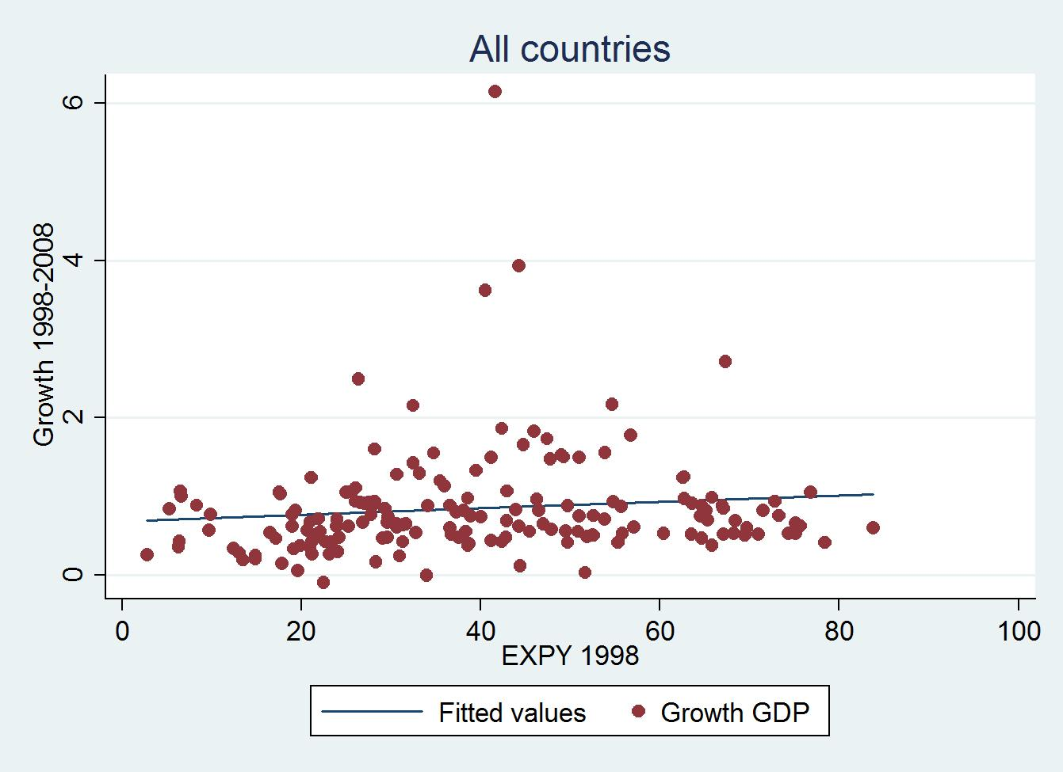
Export sophistication and growth I

Slide 9
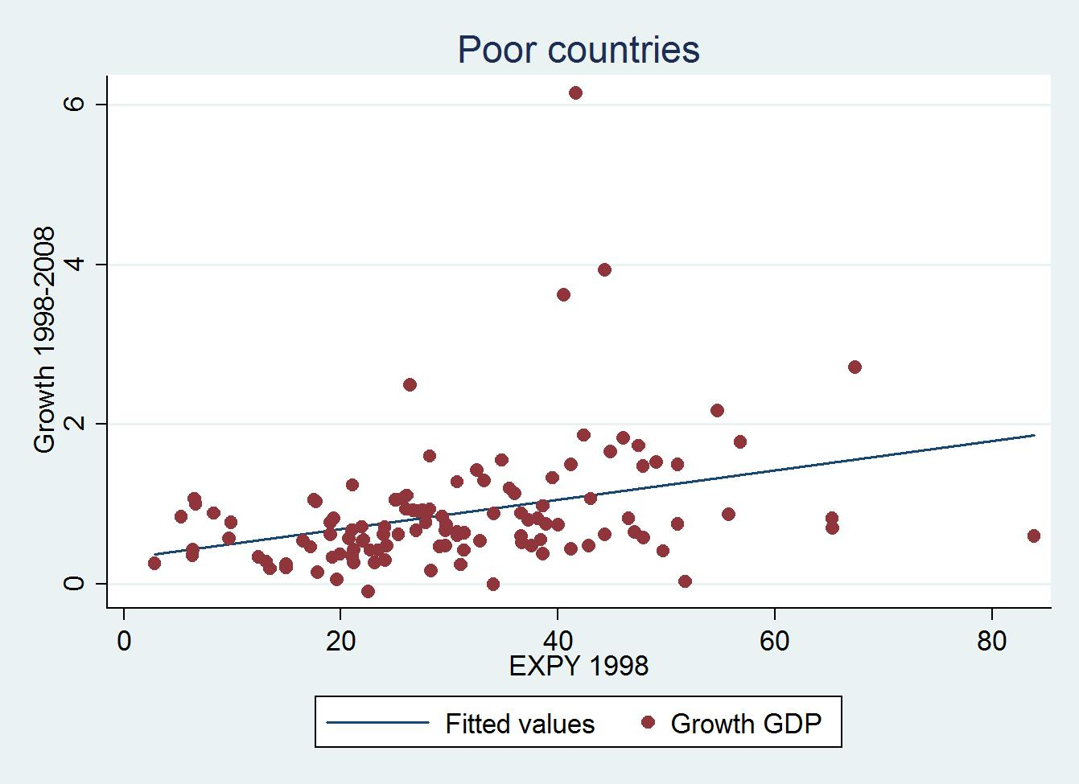
Export sophistication and growth II

Slide 10
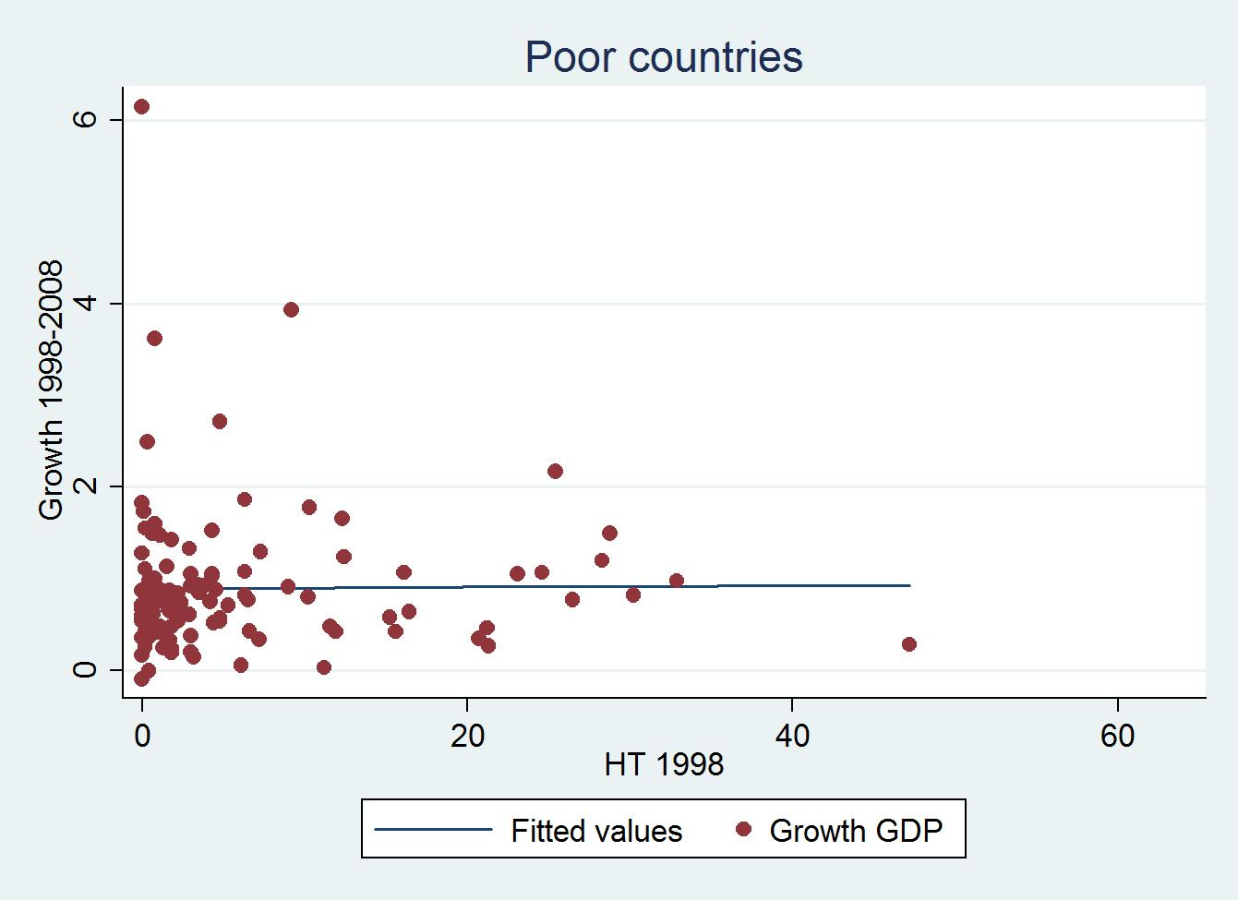
Technological intensity and growth

Slide 11
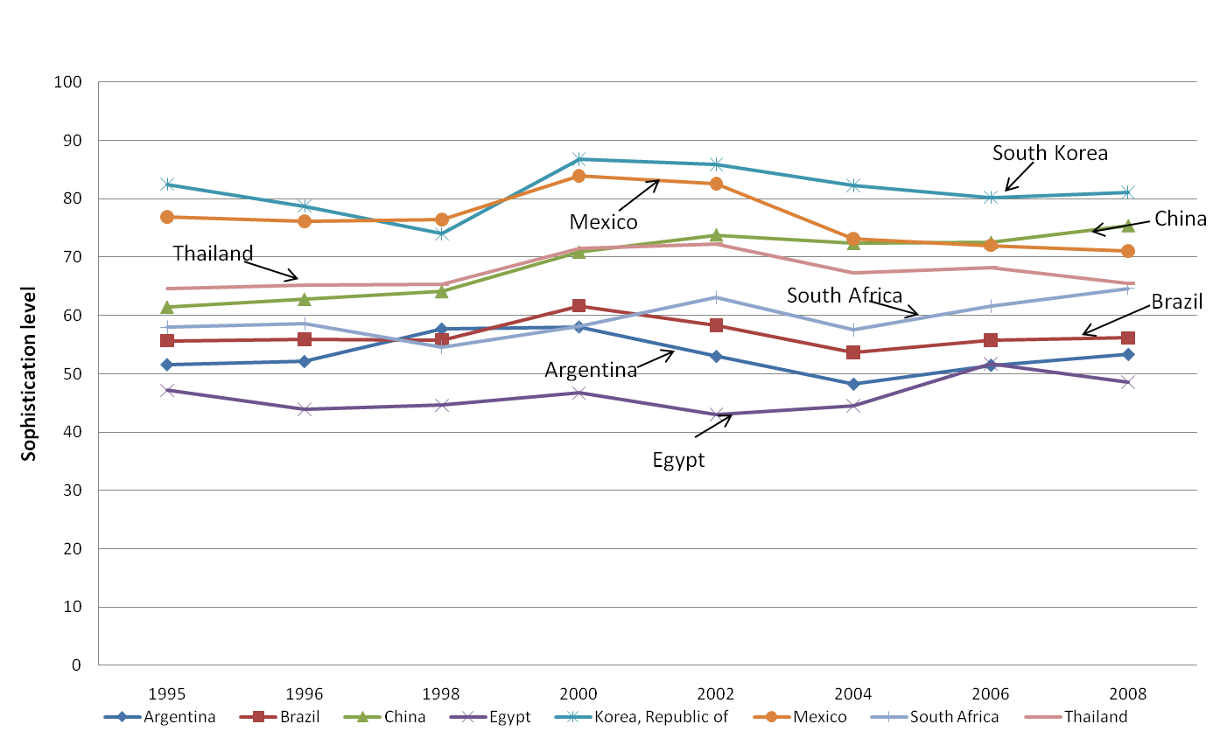
Export sophistication level selected countries
Notes:
11
11

Slide 12
Missing links
Export-led growth vs import substitution
Misreading the East Asian Miracle
investment-export nexus
Big firms export and invest
Public investment matters

Slide 13
Why investment rates differ?

Slide 14
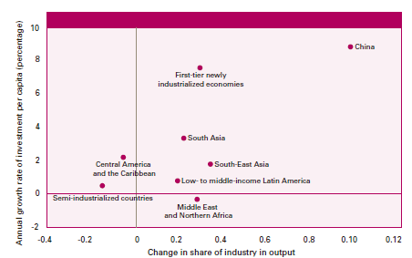
Investment is a catalyst for structural change

Slide 15
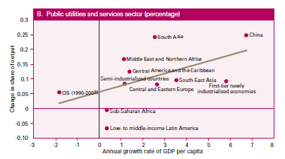
Infrastructure investment

Slide 16
New patterns of trade and investment
The role of production networks
FDI
Flying geese paradigm
Regional arrangements
A new industrial policy?
Concerns:
Trading more earning less
Footlose
Race to the bottom

Slide 17
The Rise of the South
The emergence of southern growth poles
Catching up, convergence and decoupling
The crisis has accelerated the shift
Can the South go it alone? Markets, machines and money

Slide 18
(back)
Contribution to world GDP/PPP growth 1990-2015
Annual global GDP-PPP growth rate (based on 3-yr moving average)
Source: OECD Development Centre, Perspectives on Global Development 2010 Shifting Wealth based on IMF World Economic Outlook, 2010, April
Notes: Data for 2010-2015 based on IMF projections
Notes:
18
vendredi 15 avril 2011
18

Slide 19
Catching Up?

Slide 20
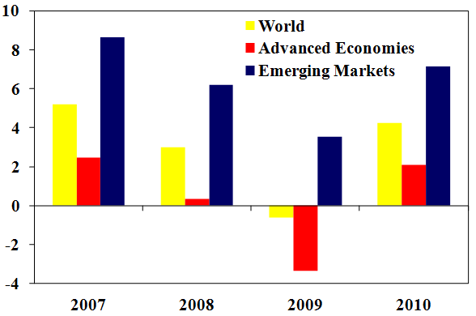
(back)
Weathering the crisis (growth rate of GDP, % change from a year earlier)

Slide 21
Developing Economies no Longer Perceived as High risk/Low return
Public Debt as % of GDP
Source: OECD Development Centre, Perspectives on Global Development 2010 Shifting Wealth based on IMF World Economic Outlook, 2010, April
Notes:
21
The average of high income countries’ debts as a share of their GDP is more than twice that of low and middle income countries, and continues to grow
21

Slide 22
Evolution of south south trade

Slide 23
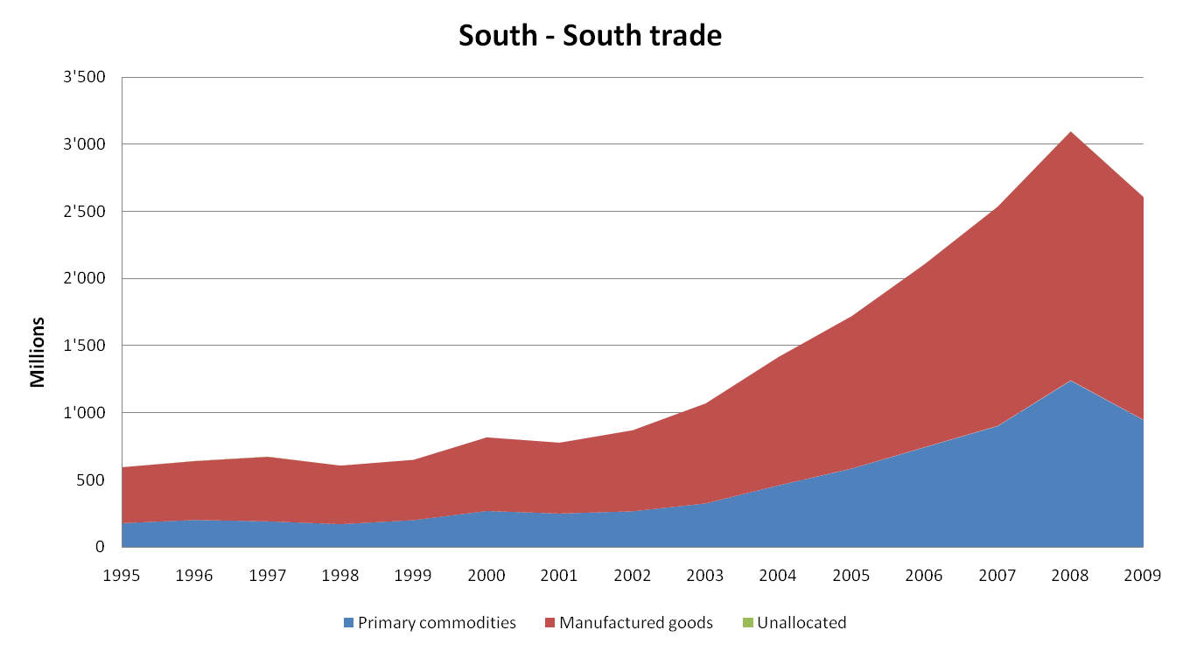
Composition of south south trade

Slide 24
South-South trade by region in 2009
Source: ECIDC,UNCTAD based on UNCTADstat.

Slide 25
Policy challenges
Avoid North South asymmetries
Terms of trade
Balance of payments
Enclaves
Exploit diversification opportunities
Financing adjustment and upgrading

Slide 26
Why Industrial policies matter even more?
Risks in South-South for least developed (polarization and commodity trap)
The middle-income trap
The limits of export led-growth
Employment creation (inclusive growth)
Financialization: a persistent threat to productive investment

Slide 27
Learning from success: Development states vs good governance
Domestic resource mobilisation
managing rents
Integrating macro, trade and industrial policies
Exchange rates
Disciplining capital (particularly finance)
Capabilities
Social policy

Slide 28
Thank you!

