Slide 1

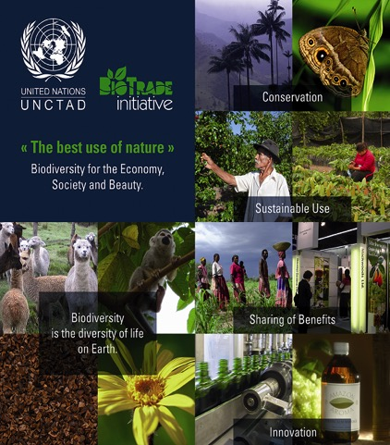
The BioTrade Initiative for the SDGs
12 April 2019 – Geneva
Lorena Jaramillo, biotrade@un.org
Economic Affairs Officer
TED/DITC
BioTrade is supported by the Swiss State Secretariat for Economic Affairs SECO, Governments of Norway, Spain, The Netherlands, as well as the UN Foundation

Slide 2
Content
  Background
1.
  BioTrade examples
2.
  Opportunities and challenges
3.

Slide 3
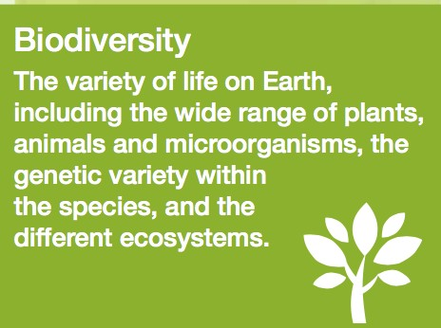
Relationship between biodiversity, livelihoods and markets
Asia: 50-80% of annual household income from biodiversity (NTFPs)
Latin American: 75% households depend biodiversity (basic needs, culture)
Livelihoods
(rural and margnialized communities: 4.2 bn people depend biodiversity)
BD is threatened (Biodiversity declined by 60% since 1970 - WWF)
AFFECTING LIVELIHOODS
Pollination of global crops is worth up to US$577 bn.
57% most prescribed USA drugs are come from biodiversity
Contribute to many industries/
sectors
(agriculture, forestry,
fisheries, pharma,
tourism…)
Affect supply chains & BD services they use
WBCSD: deforestation equals US $2-5 trillion in lost value
Sustainability markets: $2-6 trillion (2050)
Global mega- trends: health, environment, social, economic, political…
Consumer concerns / demand – 79% consumers believe companies’ obligation to assure positive impact on people and biodiversity (2018 UEBT Barometer)
Natural product sales: US$206 bn (New Hope Network)
US Organic food sales growth 8,4% (2015/6) vs. 0.6% conventional (OTA)

Slide 4

UNCTAD BioTrade Initiative
Connecting biodiversity, livelihoods and markets
Biodiversity
Livelihoods
Consumers demands & concerns
The BioTrade Initiative of UNCTAD – launched in 1996 - aims to promote trade and investment in biodiversity derived products and services to further sustainable development

Slide 5
Value chain – current and ideal
Supporting institutions and enbling policy environment
Producers, collectors (associations)
Processors
Distributors / Traders
(National - international)
Consumers
Current
Information, benefits and value added
Benefits
Knowledge, environmental responsibilty
Ideal
Inclusive & participatory approach (planning and decision)
Information, costs, benefits and environmental responsibility
Value added
Benefits

Slide 6
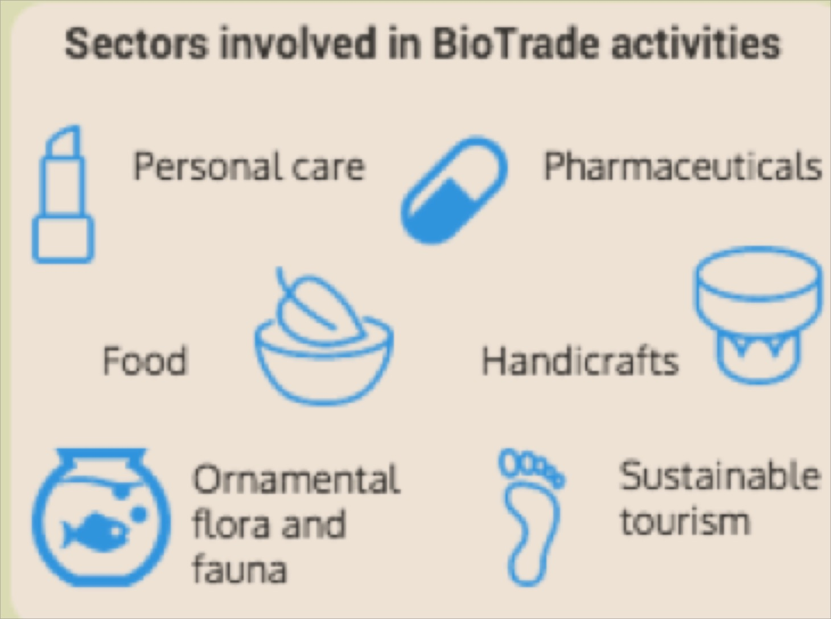
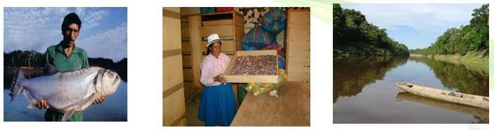
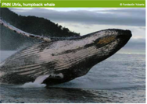

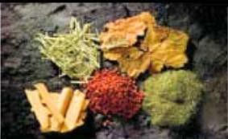





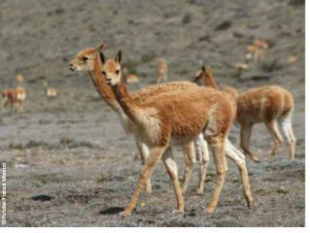
BioTrade: activities of collection, production, transformation, and commercialization of products & services derived from native biodiversity (BD) under the criteria of environmental, social and economic sustainability (BioTrade P&C)
Sectors involved in BioTrade activities
BioTrade Principles
P1. Conservation
Personal care
(Phyto) pharma
P2. Sustainable use
Food
Handicrafts
P3. Equitable benefit-sharing
P4. Socio-economic sustainability
Ornamental flora & fauna
Sustainable tourism
P5. Legal compliance
P6. Respect for actors’ rights
Forest carbon credit projects
Fashion
P7. Clear tenure & resources access

Slide 7
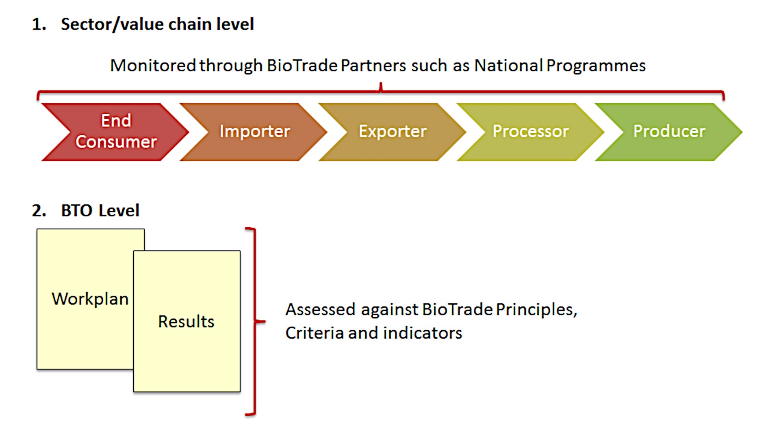
How to translate this into practice
Sustainable development – SDGs, MEAs, UNCTAD mandates
BioTrade Principles and Criteria
Select/assess companies, VC & sectors, and identify/address needs to be supported & opportunities captured

Slide 8
Build on partnerships with different actors
National and regional levels: e.g. BioTrade national and regional programmes:
selection of value chains
prioritization of activities
evaluation and selection of companies, and
develop tools to support them
Private sector level: e.g. business association and company level (VC)
Companies’ assessments and develop workplans to fulfill P&C
Elaboration of tools to support private sector in the implementation of workplans:
  to improve resource management, supply chain management, market strategies for specific niches, capacity building programmes
Production / collection
Post-harvesting
Processing
Commercializ
Consumption
National and international policy frameworks
Market access
Supply chain management
Enhance business capacity of SMEs
Funding

Slide 9





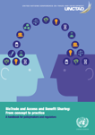


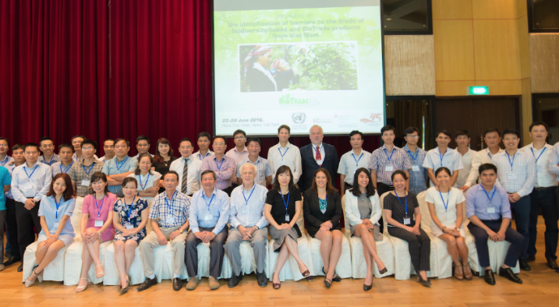
Access to markets and information
Collection -Production
Post-harvesting
Processing
Commercial
Consumption
Identify and address barriers to the trade of BioTrade products
B2B programmes, market intelligence, participate in trade fairs & commercial missions, market differentiation, documentation / traceability
© PROMPERU
© PhytoTrade Africa

Slide 10
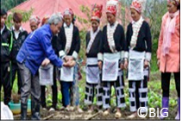
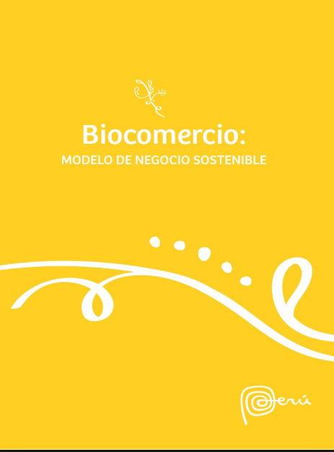
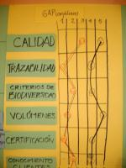
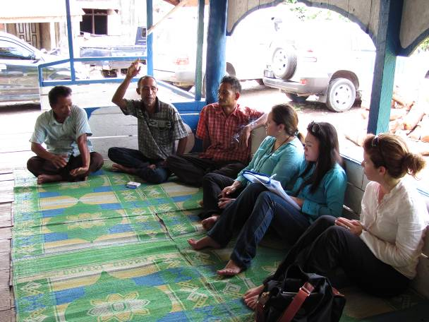
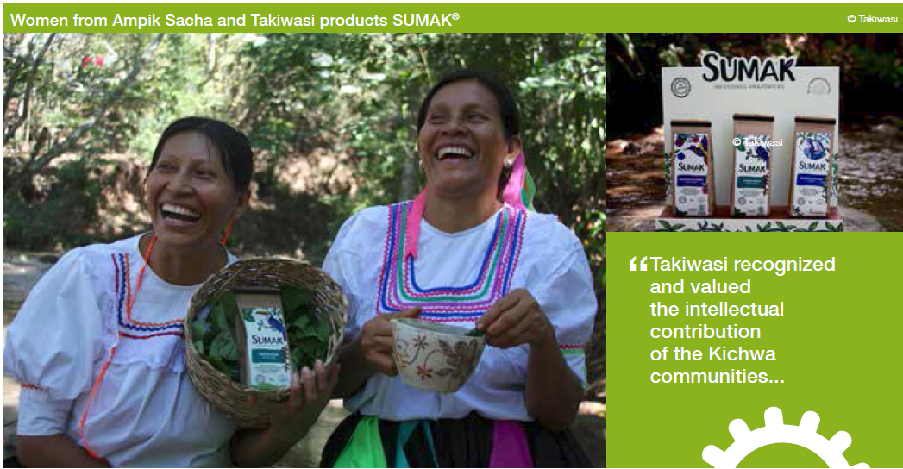
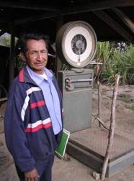

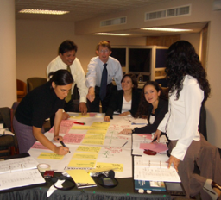
Support companies to implement social & environmental practices
Wild collection
Supply chain management: processing and quality improvements, GAPs, management plans, resource assessments, ABS
Enhance business capacity of SMEs: organization, business plans, coaching & training on business skills
Funding: PPPs, grants, credits

Slide 11

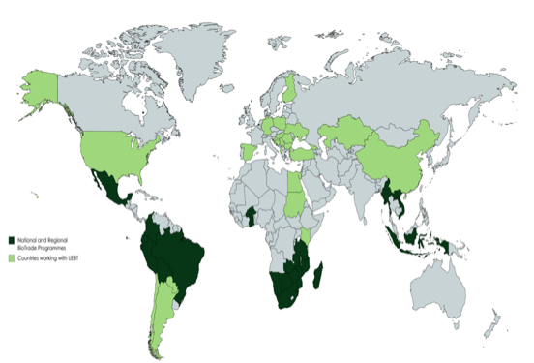
Where do we work
Activities are implemented by national, regional and international partners:
Currently implemented in 46 countries
3,500 value chains supported
Sales from BT companies/associations US$ 4.6 billion (2017)
5 million beneficiaries
(producers/farmers, collectors/hunters, workers)
Africa: Botswana, Burkina Faso*, Egypt*, Ghana*, Kenya*, Madagascar, Malawi, Mozambique, Namibia, South Africa, Sudan*, Swaziland, United Republic of Tanzania*, Zambia, Zimbabwe
Asia: Indonesia, China*, Kazakhstan*, Kyrgyzstan*, Lao People's Democratic Republic, Myanmar, Turkey*, Viet Nam.
Americas: Plurinational State of Bolivia, Argentina*, Brazil, Chile*, Colombia, Ecuador, Mexico, Paraguay*, Peru, USA*
Europe: Albania*, Bosnia Herzegovina*, Bulgaria*, Croatia*, Finland, Georgia*, Germany*, Hungary*, Poland*, Romania*, Serbia*, Spain*, Ukraine*
*Countries working with UEBT supply chains

Slide 12


Opportunities & challenges
Consumer preferences: +demand, but access?
Partnerships & knowledge built: align efforts, KS
Service provider structure and beneficiaries’ capacity & interest (e.g. skills, knowledge, financing)
Enabling policy environment: incentives, capacity and awareness

Slide 13


BioTrade and the SDGs
BioTrade national and regional programmes (Asia, Africa, Latin America) and global (UNCTAD)
NGOs, business associations: PhytoTrade Africa, Union for Ethical BioTrade (UEBT)
Development banks, UN agencies, import promotion actors..: CAF, ITC, UNDP, UNEP, SIPPO..
People (1 to 5)
Planet (6, 12-15)
Promoting livelihoods to grassroots communities (income, jobs & gender equality, food security, ABS and diversification)
Sustainable practices in land and coastal ecosystems (sustainable sourcing, CITES II & III, Blue BioTrade)
Access and benefit sharing of the benefits generated
New Global BioTrade Programme: Linking trade, biodiversity and sustainable development (2018-2022)
“There is potential to upscale BioTrade, but all practitioners need to work together to seize the opportunities that are arising and address the challenges to develop BioTrade businesses”
Prosperity (8-11, 7*)
Peace (16)
Value addition & innovation, start-ups in and technology transfer to rural communities and SMEs
Sustainable tourism activities
Income generating activities for conflict affected groups particularly in rural areas
Enhance social cohesion, dialogue and transparency - > trust
Partnerships (17)
94%
Promote S-S and N-S cooperation, and mobilization of resources
Increase/diversify exports of developing countries
@BioTradeGroup

Slide 14
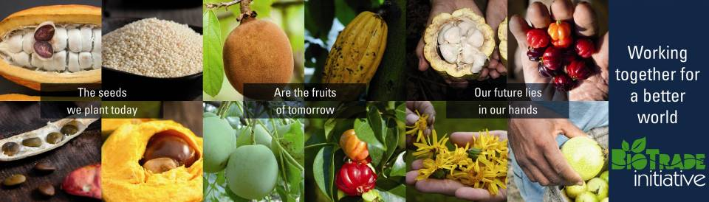
Nairobi Maafikiano –“Promote sustainable trade in biodiversity products and services to strengthen the sustainability of biodiversity and foster sustainable growth, in close cooperation with other relevant agencies where appropriate” (paragraph 76q).
Thank you very much
Further information at www.biotrade.org and biotrade@un.org
Pictures from UNCTAD, BioTrade and programmes, practitioners and partners
BioTrade is supported by the Swiss State Secretariat for Economic Affairs SECO, Governments of Norway, Spain, The Netherlands, as well as the UN Foundation and UN development account

